Slide 1
Advancing Maternal and Infant Healthcare: Driving Progress Through Policy, Technology and Practice
August 16, 2023

Slide 2





Vision
Mission
To realize the full health
potential of every human, everywhere.
Reform the global health ecosystem through the power of information and technology.

Slide 3

Welcome
Gwynne Jelbaoui
Program Manager
Clinical Informatics HIMSS
Gwynne.Jelbaoui@himss.org

Slide 4






Opportunities
https://www.himss.org/membership-participation/physician-community
Education
Community
Present webinars on topics such as: telehealth, medical informatics, AI, Interoperability, and best use of EHR systems
Volunteer and show leadership through CMIO Roundtable and Workgroups
Thought Leadership
Public Policy
Physician Community
Gain insight into current policy updates and affect change in healthcare systems and planning
Physician Executive subject matter expertise; Interview with HIMSS Media; contribute to preconference forum planning
Education Task Force
Drive education and content for the community
Physician Resources
Access career profiles, education, articles, and news items
Strategic Partners
Collaborate with high profile Physician Societies such as AMDIS, EHRA, and AMIA

Slide 5
Advancing Maternal and Infant Healthcare: Driving Progress through Policy, Technology and Practice
Learning Objectives
Gain knowledge of the current bills under review with our government leaders.
Utilize tools to take immediate action to notify government leaders of the importance of these bills.
Develop a comprehensive understanding of the impact of connecting to patients via telehealth and the related improvements to maternal outcomes.
Explore the potential enhancements to care and patient outcomes via secure mobile data sharing.

Slide 6
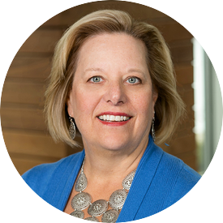
Moderator
Sue Kressly, MD, FAAP​
Pediatric Health IT Subject Matter Expert
Chair at American Academy of Pediatrics
Founding Partner at Kressly Pediatrics

Slide 7

Nwando Anyaoku, MD, MPH, MBA
VP, Chief Health Equity Officer at Providence North Division
Dr. Nwando Anyaoku is a physician executive, speaker, coach and consultant based in Seattle, Washington.
A board-certified pediatrician, Dr. Anyaoku serves as VP and Chief Health Equity officer for Providence Swedish Health Services. Working closely with clinical and community leaders, she leads efforts in advancing equity in healthcare and the delivery of culturally competent care, with an emphasis on technology and digital innovation. She is an experienced executive and physician leader with expertise in clinical and business decision making. Dr Anyaoku is faculty at Carnegie Mellon University Master of Medical Management program. As a strategic advisor and consultant, she not only specializes in health equity, but also provides leadership development and supports physicians and executives in every aspect of their leadership journeys, including career reimagining and strategic planning.
Dr. Anyaoku is best known for her strong commitment to helping people and communities thrive and bloom where they are planted. When she’s not coaching and supporting medical leaders or speaking at conferences and special events, Dr. Anyaoku serves as an active board member for several regional and national boards of directors. Dr. Anyaoku is a proud mother of two boys and an avid reader, traveler, and cook.

Slide 8

Nakyda Dean, MD
OB/GYN at Tuba City Regional Health Care Corporation
Dr. Nakyda Dean was born in Chicago, Illinois, and graduated from Cornell College. She obtained her medical degree at Loyola University Chicago, Stritch School of Medicine. Her residency was at Rush University Medical Center in Obstetrics and Gynecology, and she completed her training with a global health fellowship called HEAL Initiative at the University of California San Francisco.
Dr. Nakyda Dean is dedicated to providing care to underserved and under-resourced communities. She currently works at a tribal hospital on Navajo Nation.
Dr. Dean is an aspiring clinical informaticist, bridging information technology and innovation to enhance individual and population health outcomes, dismantling health disparities, improving patient care, and strengthening the clinician-patient relationship.

Slide 9
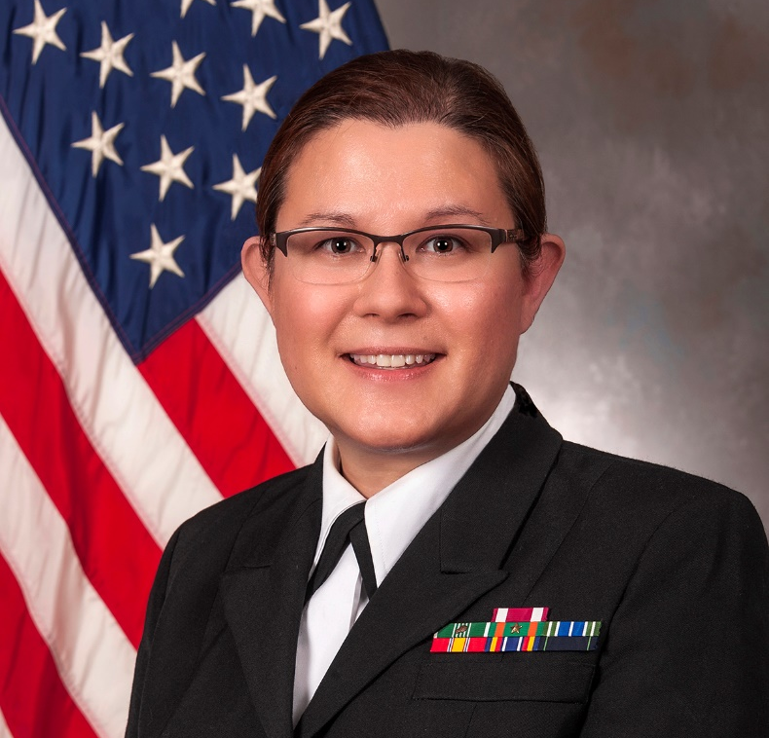
Monica Lutgendorf, MD
Dept Chair, Gynecologic Surgery & Obstetrics at Uniformed Services University of the Health Sciences; Maternal-Fetal Medicine Physician, Walter Reed National Military Medical Center
CAPT Monica Lutgendorf earned her Medical Doctorate in 2004 from the Uniformed Services University of the Health Sciences, completed internship and residency in Obstetrics and Gynecology at Naval Medical Center Portsmouth in 2008, and her subspecialty fellowship in Maternal-Fetal Medicine at Madigan Army Medical Center in 2014.
She currently serves as Professor and Chair of the Department of Gynecologic Surgery & Obstetrics at the Uniformed Services University of the Health Sciences. Her research interests include technology in medicine, simulation, quality improvement and domestic violence and posttraumatic stress disorder in pregnancy and the military.
The views expressed are those of the author and do not necessarily reflect the official policy or position of the Uniformed Services University of the Health Sciences (USUHS), Department of the Navy, Department of the Air Force, Department of the Army, Department of Defense, or the United States Government. Mention of trade names, commercial products, or organizations does not imply endorsement by the U.S. Government.

Slide 10

Rachel Peragallo Urrutia, MD
Assistant Prof of OB/GYN and Preventive Medicine Resident at University of North Carolina
Dr. Rachel Peragallo Urrutia is an Associate Professor of Obstetrics and Gynecology and is also board certified in Preventive Medicine. She provides prenatal and delivery care for patients at UNC. She is a consultant for the North Carolina Department of Health and Human Services Women Infant and Community Wellness Section.
Dr. Rachel Peragallo Urrutia is the one of the principal investigators on the Accountability for Care through Undoing Racism and Equity for Moms, a cluster randomized trial that is testing data accountability and transparency tools created together with the NC Health Information Exchange Authority to reduce disparities in maternal and infant health outcomes.

Slide 11
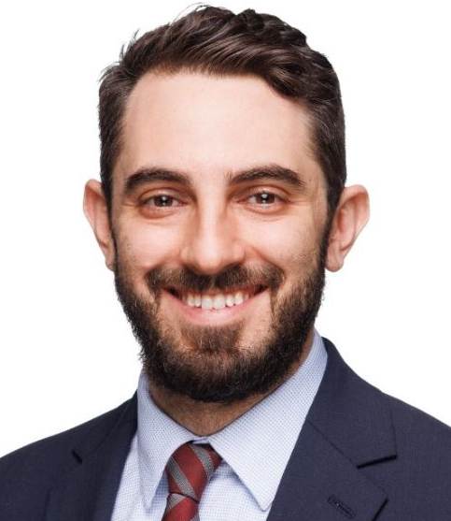

David Gray
Director of HIMSS Government Relations
Valerie Rogers
Director of HIMSS Government Relations

Slide 12
Maternal Health Legislative Activity on Capital Hill

Slide 13
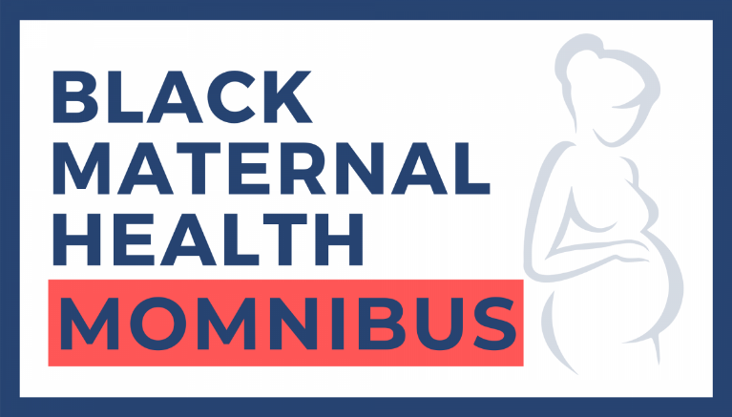
Black Maternal Health Momnibus Act (aka Momnibus)
Introduced in the House and Senate on May 15, 2023 in honor of Mother’s Day
  Led by Representatives Adams and Underwood in the House and Senator Booker in the Senate
  The House bill has 190 cosponsors, while the Senate bill has 30 cosponsors – all Democrats
Momnibus Act is a comprehensive legislative package composed of 13 sections that address every leading driver of maternal mortality and morbidity in the United States and tackle long-standing health care disparities.
Each section of the Momnibus package has been introduced as a
standalone bill in both the House and Senate, allowing individual bills to
move forward without waiting for the entire package to be signed into
law.
Momnibus package endorsed by over 200 organizations, including HIMSS.
Momnibus Bills signed into law in 117th Congress
  Protecting Moms Who Served Act (Signed into Law 11/30/21)
  One provision of the Data to Save Moms Act – funding for maternal health research at Minority-Serving Institutions – was enacted through the Fiscal Year 2023 government spending package.

Slide 14
Black Maternal Health Momnibus Act Bills/Sections
Social Determinants for Moms Act (HR. 3322 /S. 1594)
  Led by Representative Jahana Hayes and Senator Richard Blumenthal
Extending WIC for New Moms Act (HR. 3332 /S. 1593)
  Led by Representative Lucy McBath and Senator Richard Blumenthal
Kira Johnson Act (HR. 3310 /S. 2239)
  Led by Representative Alma Adams and Senator Raphael Warnock
Maternal Health for Veterans Act (HR. 3303 /S. 2026)*
  Led by Representatives Lauren Underwood and Gus Bilirakis and Senators Tammy Duckworth and Susan Collins
Perinatal Workforce Act (HR. 3532 /S. 1710)
  Led by Representative Gwen Moore and Senator Tammy Baldwin
Data to Save Moms Act (HR. 3320 /S. 1599)
  Led by Representative Sharice Davids and Senator Tina Smith
Moms MATTER Act (HR. 3312 /S. 1602)*
  Led by Representatives Lisa Blunt Rochester and Brian Fitzpatrick and Senator Kirsten Gillibrand
Justice for Incarcerated Moms Act (HR. 3344)
  Led by Representative Ayanna Pressley
Tech to Save Moms Act (HR. 5066 /S. 1699)*
  Led by Representatives Williams, Underwood, Joyce, and Hinson and Senators Bob Menendez and Dan Sullivan
IMPACT To Save Moms Act (HR. 3346 /S. 1797)
  Led by Representative Jan Schakowsky and Senator Bob Casey
Maternal Health Pandemic Response Act (HR. 3304 /S. 1605)
  Led by Representatives Lauren Underwood and Senator Elizabeth Warren
Protecting Moms and Babies Against Climate Change Act (HR. 3302 /S. 1601)
  Led by Representative Lauren Underwood and Senator Ed Markey
Maternal Vaccination Act (HR. 3348 /S. 1603)
  Led by Representative Terri Sewell and Senator
  Tim Kaine
  * denotes bipartisan bill

Slide 15
Tech to Save Moms Act (H.R. 5060/S. 1699)
Introduced by Representatives Williams, Underwood, Joyce, and Hinson and Senators Bob Menendez and Dan Sullivan Johnson and Senator Menendez
The Tech to Save Moms Act would make investments in evidence-based digital health tools to reduce maternal mortality, severe maternal morbidity, and maternal health disparities – particularly in rural and underserved communities – and close racial and ethnic gaps in maternal health outcomes.
Specifically, the Tech to Save Moms Act would:
  Require the Center for Medicare & Medicaid Innovation (CMMI) to consider models that improve the integration of telehealth services in maternal health care through screening and treating common pregnancy-related complications for Medicaid enrollees.
  Establish a grant program to evaluate, develop, and expand the use of technology-enabled collaborative learning and capacity building models for providers, students, and other professionals to treat pregnant and postpartum individuals
  Establish a grant program to promote access to digital tools designed to address racial and ethnic disparities in maternal health outcomes, particularly in rural underserved communities.
  Commission a comprehensive study on the use of technology in maternity care to reduce maternal mortality, morbidity, and disparities.

Slide 16
Data to Save Moms Act (H.R. 3320/S. 1599)
Introduced by Representative Davids (D-KS) and Senator Smith (D-MN)
The Data to Save Moms Act would support greater levels of representative community engagement in MMRCs and promote improvements in data collection processes, quality measures for maternity care, and maternal health research at Minority-Serving Institutions (MSIs). Lastly, it would respond to the urgent maternal health crisis among Native Americans.
Specifically, the Data to Save Moms Act would:
  Promote greater diversity and community engagement in state and Tribal MMRCs.
  Conduct a comprehensive review of maternal health data collection process and quality measures in coordination with key stakeholders and make recommendations in response to the review
  Require a comprehensive review on existing maternal health data collection processes and quality measures, as well as funding support, and make recommendations to improve them.
  Commission a comprehensive study on maternal mortality and severe maternal morbidity among Native American pregnant and postpartum people.
  Invest in maternal health research at MSIs like HBCUs, TCUs, HSIs, and AAPISIs to study maternal mortality, severe maternal morbidity and other adverse maternal health outcomes for specific racial and ethnic minority groups.

Slide 17
Bipartisan Maternal Health Legislation
Connected Maternal Online Monitoring (MOM) Act (S. 712/not yet introduced in the House)
  Bipartisan bill led by Senators Cassidy, Hassan, Young, Carper, Thune, and Rosen
  This bill would require CMS to report, and provide resources for states, on coverage of remote physiologic devices and related services (e.g., blood glucose monitors) under Medicaid, and improve maternal and child health outcomes for pregnant and postpartum women.
Preventing Maternal Deaths Reauthorization Act of 2023 (H.R. 3838)
  Bipartisan bill led by Representatives Kelly, Burgess, Carter, DeGette, Cammack, and Castor
  This bill would assist states in preserving maternal health throughout pregnancy, childbirth, and postpartum, addressing disparities in maternal health outcomes and find solutions to enhance health care quality and outcomes for mothers.
Healthy Moms and Babies Act (S. 948/H.R. 4605)
  Bipartisan, bicameral bill led by Senators Grassley and Hassan, and Representatives Carter and Bishop
  Comprehensive legislation to combat the maternal mortality crisis by improving maternal and child health through increased services, supports, and access to high-quality coordinated care, supporting women and babies with 21st-century technology, such as telehealth, and taking additional steps including “whole person” care, stillbirth prevention, and improving our understanding of social determinants of health in pregnant and postpartum women.
  Includes language from the Connected MOM Act

Slide 18

Opportunities to Support the Momnibus Act
Contact your elected officials and urge Congress to hold hearings and markups of Momnibus bills!
  Find your Representatives here: https://www.house.gov/representatives/find-your-representative
  Find your Senators here: https://www.senate.gov/senators/senators-contact.htm
Raise awareness on the Momnibus through social media!
  The Caucus has a social media digital toolkit on their website: https://blackmaternalhealthcaucus-underwood.house.gov/Momnibus
  Share your stories on why this issue is important to you and be sure to tage the Black Maternal Health Caucus at https://twitter.com/BMHCaucus
Urge your elected officials to cosponsor the Black Maternal
Health Momnibus Act package and individual bills!
  HIMSS Legislative Action Center website will be launching an advocacy
  campaign in support of the Momnibus shortly!
  The campaign will be posted here: https://himss.quorum.us/

Slide 19
HIMSS State Engagement Roundtable Report: Developing a Digital Tech-Enabled Maternal Health Action Plan
Recommended State Policy Actions for Women's Health
Valerie Rogers, Senior Director, HIMSS Government Relations

Slide 20
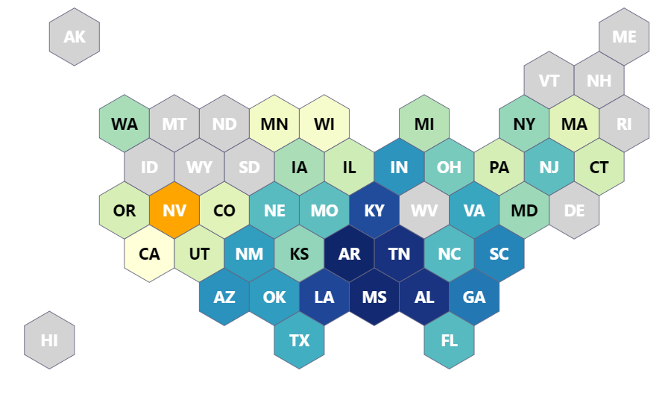
Top 10 States Highest Maternal Mortality
Arkansas 43.50
Mississippi 43
Tennessee 41.70
Alabama 41.40
Louisiana 39
Kentucky 38.40
Georgia 33.90
South Carolina 32.70
Arizona 31.40
Indiana 31.10
Per 100K Live Births
Ref: https://worldpopulationreview.com/state-rankings/maternal-mortality-rate-by-state

Slide 21
HIMSS Recommended State Policy Actions to Address the Maternal Mortality Crisis
We affirm the need for a comprehensive approach to maternal health by leveraging cross-sector data, telehealth, remote patient monitoring, and novel personal health technology solutions. HIMSS recommends the following:
  Enact Momnibus legislation at the state level to correspond to national legislation and maternal health policy priorities
  Enable access to digital self-monitoring tools for women at little to no out-of-pocket cost to the patient
  Strengthen and provide support for women's health, family planning, and reproductive health services by increasing and improving reimbursement for care, starting with preconception through all phases of pregnancy and the first year postpartum, via integrated telehealth models for maternity care services
  Provide funding to expand the use of technology-enabled collaborative learning and capacity models for pregnant and postpartum women (may include new AI functions)

Slide 22
Recommended State Policy Actions to Address the Maternal Mortality Crisis Cont’d
  Provide funding for electronic data collection, surveillance, and research on maternal health outcomes in accordance with current data modernization efforts
  Develop cross-sector data platforms or data lakes by collaborating with health information exchanges and other community partners to inform collection and analysis by the state MMRCs
  Support active engagement of birthing hospitals, licensed birth centers, and perinatal providers in quality improvement efforts and regular reporting to state/regional health information exchanges for improved surveillance and vital statistics
  Coordinate with CMS to advance the use of Section 1115 Medicaid demonstration waivers to pilot interventions using evidence-based health IT strategies and interoperable solutions

Slide 23
Maternal Mortality Review Committees (MMRCs) & State HIEs and Data Hubs
According to recent reports by the Guttmacher Institute, 49 states, the District of Columbia, New York City, Philadelphia and Puerto Rico have a formal maternal mortality review committee or legal requirement to review pregnancy-related deaths
Historically, MMRCs were almost exclusively composed of physicians, now MMRCs have expanded their committees to include a wider representation of the community, e.g., midwives, doulas, pathologists, behavioral health experts, representatives from tribal nations, and community-based organizations
Recently, with current health data modernization advancements, MMRCs are able to gather information beyond what is available through vital statistics data, including reviewing various institutional records (e.g., medical files, law enforcement reports, autopsy records, etc.)
State HIEs and Medicaid Data Hubs such as the Indiana Management Performance Hub Equity Portal for Infant and Maternal Health Data are examples of how MMRCs and researchers can assess Medicaid, SDOH and other health and human services data to inform policies and interventions.
          References: https://www.guttmacher.org/state-policy/explore/maternal-mortality-review-committees and https://hub.mph.in.gov/lt/dataset/equity-portal-infant-and-maternal-health-data

Slide 24
Recent State Legislation and Policies to Watch
Tennessee SB177 and HB567
    Leverages cross-sector data, telehealth, remote patient monitoring, and novel personal health technology solutions. We commend your forward use of federal waivers to execute a pilot program and encourage your consideration of data modernization funding for more timely electronic data collection, surveillance, and research on maternal health outcomes
Georgia SB106 and HB19,
  SB106 creates a remote maternal and fetal health monitoring program for Medicaid-eligible, high-risk pregnant mothers, and HB 19 includes $1 million to support the pilot program. The program will use digital technology to perform remote monitoring, tracking maternal heart rate, measuring blood pressure, etc.
Pennsylvania SB262
  Introduced by Women’s Health Caucus co-chair Sen. Judy Schwank, the legislation requires the Pennsylvania Department of Health to report severe maternal morbidities by tracking the health issues that mothers go through during pregnancy and birth, including listing “severe maternal morbidity” on death certificates and hospital discharges. The data will also be used to prevent outcomes like preterm births, C-sections, and postpartum complications

Slide 25


Call to Action! Public Policy Strategic Actions for Maternal Mortality Prevention in Your State!
Connect with your state health officer, Medicaid Directors, and Community Health Centers Stakeholders to learn more about opportunities to advance RPM, Telehealth, electronic reporting, wearables, and interoperability across the spectrum of care
Support the expanded use of telehealth and Medicaid reimbursement for maternal health in your state
HIMSS Legislative Action Center

Slide 26
Resources
https://www.himss.org/what-we-do-public-policy-advocacy/maternal-health-state-community-health-actions
https://www.himss.org/resources/developing-digital-tech-enabled-maternal-health-roundtable-report
https://www.guttmacher.org/state-policy/explore/maternal-mortality-review-committees
https://hub.mph.in.gov/lt/dataset/equity-portal-infant-and-maternal-health-data
https://www.medicaid.gov/medicaid/section-1115-demonstrations/about-section-1115-demonstrations/index.html

Slide 27
Questions?

Slide 28


Panel Discussion

Slide 29
Questions from the attendees?
Notes:
Thank you all for sharing your wealth of knowledge in this area. We will now open up for a Q&A session with our presenters. Please enter any questions you have in the Q&A feature, and I will pose the questions to the panel as they come in.
*On Monday, there was an announcement that CVS health foundation awards $6.6 million in grants to maternal health services. In addition to ensuring bills are passed by our government leaders, what do you hope to see accomplished in the near future to reduce the maternal health crisis we are facing in the US?

Slide 30




Thank you, Speakers!!
Sue Kressly, MD, FAAP
Moderator
Pediatric Health IT Subject Matter Expert
Chair at American Academy of Pediatrics
Founding Partner at Kressly Pediatrics
Nakyda Dean, MD
OB/GYN at Tuba City Regional Health Care Corporation
Rachel Peragallo Urrutia, MD
Assistant Prof of OB/GYN and Preventive Medicine Resident at University of North Carolina
Nwando Anyaoku, MD, MPH, MBA
VP, Chief Health Equity Officer at Providence North Division
Monica Lutgendorf, MD
Dept Chair, Gynecologic Surgery & Obstetrics at Uniformed Services University of the Health Sciences
Maternal-Fetal Medicine Physician, Walter Reed National Military Medical Center

Slide 31


Thank you!
Contact email:
Gwynne Jelbaoui
Gwynne.Jelbaoui@himss.org

