Slide 1
Expanding Pharmacists’ Participation in Value-Based Arrangements (VBAs): A Look at NCPDP Standards & its VBA Roadmap
Pharmacy Informatics Town Hall
September 27, 2022

Slide 2



As a mission-driven non-profit, HIMSS offers a unique depth and breadth of expertise in health innovation, public policy, workforce development, research and analytics to advise global leaders, stakeholders and influencers on best practices in health information and technology.
HIMSS is a global advisor and thought leader supporting the transformation of the health ecosystem through information and technology.
With more than 350 employees, HIMSS has operations in:
North America | Asia Pacific | Europe | Latin America | Middle East | United Kingdom

Slide 3
About NCPDP
Founded in 1977, NCPDP is a not-for-profit, ANSI-accredited, Standards Development Organization with over 1,500 members representing virtually every sector of the pharmacy services industry.
NCPDP members have created standards such as the Telecommunication Standard and Batch Standard, the SCRIPT Standard for e-Prescribing, the Manufacturers Rebate Standard and more to improve communication within the pharmacy industry.
Our data products include dataQ®, a robust database of information on more than 80,000 pharmacies, HCIdea®, a database of continually updated information on more than 2.5 million prescribers, and resQ™, an industry pharmacy credentialing resource. NCPDP's RxReconn® is a legislative tracking product for real-time monitoring of pharmacy-related state and national legislative and regulatory activity.
www.ncpdp.org
3

Slide 4


Lee Ann Stember
President & CEO, NCPDP
Lee Ann Stember is President & CEO of NCPDP, a not-for-profit multi-stakeholder forum for developing healthcare business solutions, including ANSI-accredited standards for electronic exchange of healthcare information. As President & CEO for four decades, she has led NCPDP to continued success in its transformative role in pharmacy services, creating and promoting adoption of consensus-based standards and best practices that improve patient safety and decrease costs.
Stember represents NCPDP and the work of its membership to government agencies, other standards development organizations, healthcare industry associations and coalitions seeking to achieve HIT interoperability and other reforms that improve the coordination and quality of care while reducing system costs.

Slide 5
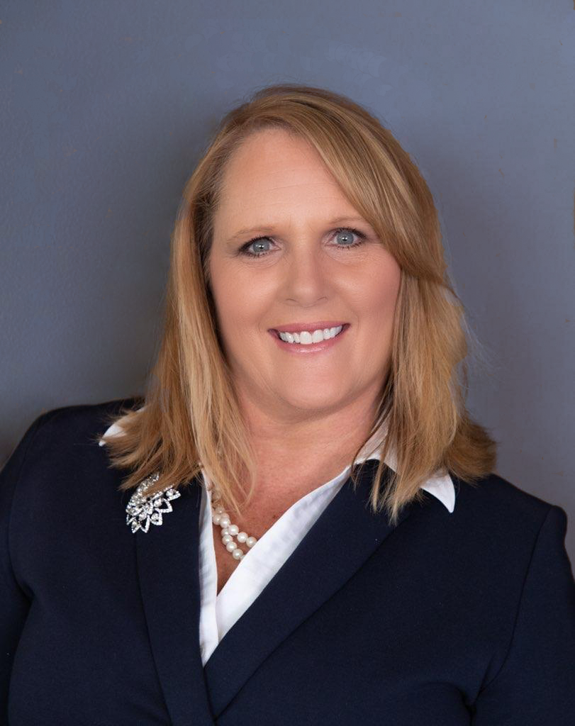
Kim Boyd
Industry Consultant, Member of NCPDP Board of Trustees
Kim Boyd is an Industry Consultant with over 25 years’ experience in health care. She specializes in strategic planning, health care policy, market intelligence, interoperability, Health Information Technology (HIT) and health care standards. Kim’s early health care experience was in the worker’s compensation market but over the last 15 years her focus has spanned Medicare, Medicaid, and commercial markets.
Kim has developed and executed on Federal and state health care policy, legislative and regulatory advocacy, stakeholder and industry engagement, and standards engagement across several health care priorities, including but not limited to electronic prior authorization, real-time prescription benefit, patient access and affordability, data and cost transparency and exchange. Kim is a 21-year member of the NCPDP, a NCPDP Board of Trustee, Co-Chair of NCPDP’s Strategic Planning Committee, Chair of the Value Based Agreement Subcommittee, and former task group lead for the Prior Authorization Transactions task group. Kim is also active in the Health Level 7 (HL7) Accelerator CodeX, leading the Prior Authorization in Oncology use case.

Slide 6
Disclosures
Lee Ann Stember has no relevant financial relationships with ineligible companies to disclose.
Kim Boyd is a past employee of McKesson. All relevant financial relationships have been mitigated.
6

Slide 7

Lee Ann Stember

Slide 8
Learning Objectives
At the end of this presentation, pharmacists and pharmacy technicians will be able to:
1. Describe why standards support for pharmacist participation in Value-Based Arrangements (VBAs) is a National Council of Prescription Drug Program (NCPDP) strategic priority.
2. Name the NCPDP standards that can support pharmacists’ participation in VBAs today.
3. Describe a use case for the role of a pharmacist in a VBA.
4. Name two quality measures that support quality improvement in VBAs.
8

Slide 9

Providing standards support for pharmacist participation in Value-Based Arrangements (VBA) is an NCPDP priority
The Time Is Now.
Industry focus on value
Gaps in care in rural and underserved populations
Aging U.S. population, chronic conditions
Pandemic

Slide 10
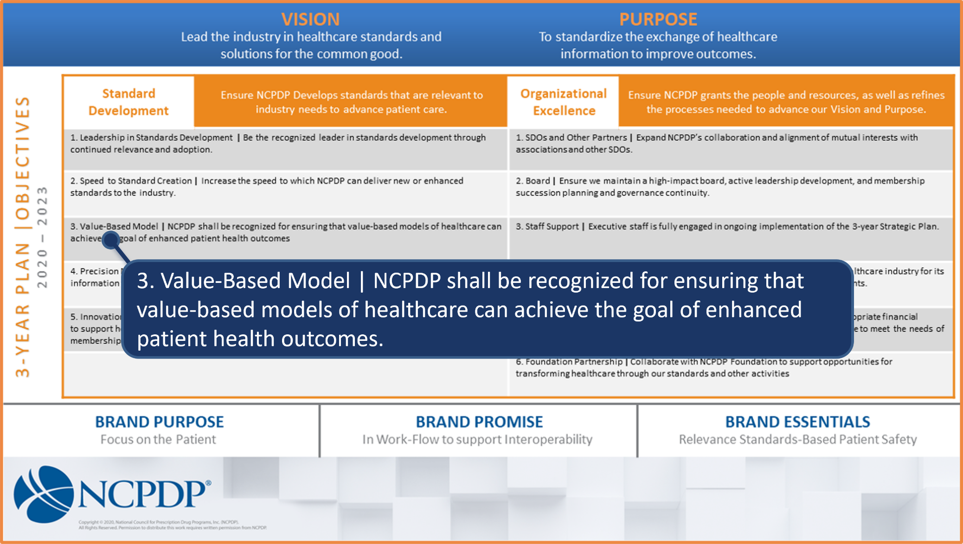
An NCPDP Strategic Priority is to ensure the goal of VBAs to enhance outcomes and lower total cost of care

Slide 11
Pharmacists can help optimize the success of VBAs
Close gaps in care – provide comprehensive, collaborative care
including Medication Therapy Management (MTM).
Medication therapy optimization can help reduce total cost of care.
Clinical pharmacists are the medication experts.
Pharmacists are well positioned to perform a variety of
patient care functions.
  Administer Immunizations;
  Testing;
  Manage medication therapies;
  Monitor patient therapies when transitioning from hospital to home;
  Measure/monitor blood pressure, blood sugar;
  Participate in outcomes reporting; and more!
With nearly 9 in 10 Americans living within 5 miles of a community pharmacy, your pharmacist may be the health professional you see most often and talk with about your health.¹
¹ https://www.cdc.gov/heartdisease/pharmacist.htm

Slide 12
Pharmacists can help optimize the success of VBAs
Pharmacists-provided services can effectively augment physician care and assist in closing gaps in care.
  Population health management;
  Medication therapies;
  Care plan coordination;
  Social Determinants of Health (SDoH)
Pharmacists were on the front lines of the
pandemic, providing clinical services –
COVID-19 testing and immunization.
Patients visit their community pharmacist 12 times more frequently that they visit their primary care provider.²
² https://www.fdsrx.com/expanding-role-community-pharmacists/

Slide 13
The shift to a more comprehensive, patient-centered model of care for pharmacists is occurring
Clinical pharmacists are involved in direct patient care; they spend little time dispensing prescriptions.³
Collaborative practice agreements (CPAs) with physicians
Consulting contracts with physician groups
Readiness to participate in VBAs exists within the
community pharmacy community.
Clinical pharmacists recommend medications to give to patients and oversee the dosage and timing of the delivery of those medications. They also may conduct some medical tests and offer advice to patients. ³
³ https://www.bls.gov/ooh/healthcare/pharmacists.htm#tab-2

Slide 14


Standards are necessary to support interoperable, bi-directional, real-time exchange of information
  Standards are needed.
  Using existing NCPDP Standards, pharmacists already collect – or can collect and document - much of the data that would be valuable in a VBA with pharmacist participation.
  There are hurdles to overcome to enable sharing that data and integrating pharmacists into VBAs.

Slide 15



NCPDP has a role in supporting in VBAs
As a problem-solving forum and ANSI-accredited SDO, NCPDP is a natural fit for looking at how standards can better support value-based models of care that are inclusive of pharmacists.
Existing NCPDP standards, modifications
Migrate information into other standards
New standards created by NCPDP or in collaboration with other SDOs
Collaboration with other SDOs - interoperability between medical and pharmacy

Slide 16


NCPDP has a role in supporting in VBAs
Research and discovery have been key to advancing our goal to provide standards support for Value-Based Arrangements.
Learn as much as possible about use of VBAs in industry, pharmacy participation, requirements, quality measures and information gaps.

Slide 17
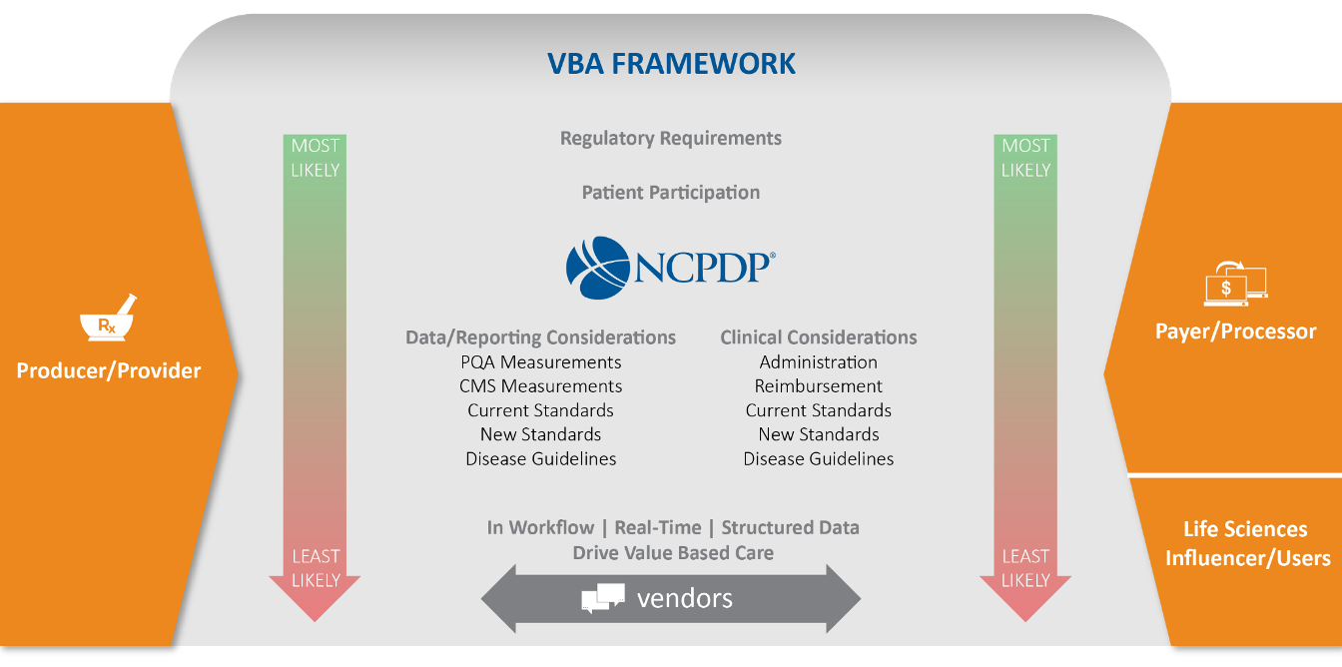
NCPDP’s VBA Framework

Slide 18

NCPDP Standards already have data elements to support pharmacists’ participation in VBAs
Analysis of existing standards for existing transactions that can support VBA :
  NCPDP Telecommunication Standard
  NCPDP SCRIPT Standard
  NCPDP/HL7 eCare Plan

Slide 19
NCPDP Standards already have data elements to support pharmacists’ participation in VBAs
67%
62%
42%
19

Slide 20
Kim Boyd

Slide 21

The NCPDP Standards Road to Value
One and half years into the Three-Year Strategic Plan
Strategic Planning VBA Subcommittee has been focused on fact finding and execution
  Determine how NCPDP current or future standards can support and promote the growth of pharmacist as a part of the care team in relation to value-based arrangements
  Collaborated with NCPDP staff, NCPDP membership, the pharmacy and medical services industry
    Evaluate where we are today in being able to truly support this growth and not only with a focus on NCPDP standards but also on evaluating and measuring pharmacist inclusion in VBAs and industry readiness to do so

Slide 22
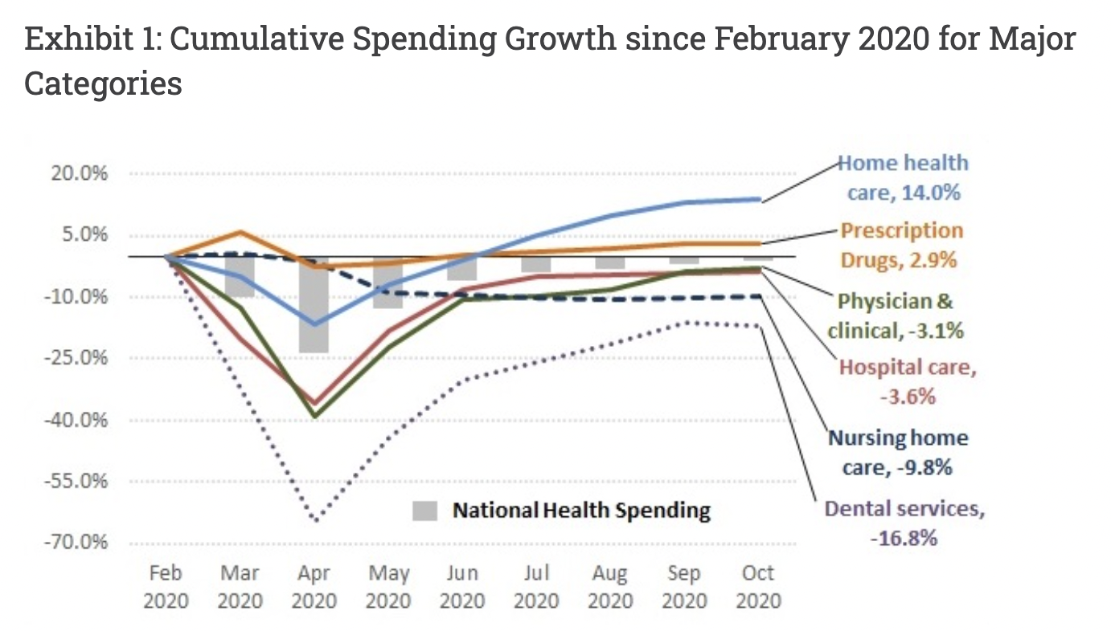
COVID
COVID shocked the healthcare system, while physician clinic and hospital visits shrank, pharmacy grew
Pharmacies have increasingly become immersed in service-related care for patients
Pharmacist clearly stepped into a clinical, collaborative role during and beyond the COVID-19 pandemic, administering vaccines as well as other clinical services
State regulations are evolving to support Pharmacist practicing at the top of their license and billing for patient-focused, consultative services, not just dispensing
https://www.healthaffairs.org/do/10.1377/forefront.20201214.543463/full/

Slide 23

Closing Gaps In Care via VBA is a Community Approach
NCPDP held a series of Stakeholder Action Groups and an Educational Summit to ascertain the healthcare community's opinions and expertise
The VBA Subcommittee also conducted 1:1 interviews
Industry Subject Matter Experts From Across the Healthcare Ecosystem Have Informed Findings and Needs to Support Pharmacist Engaged VBAs:
Pharmacies
National Quality Organization
HIT Solutions Vendors
VBA Platform Vendors
Manufacturers
Health Plans
Advocacy Organizations
Pharmacist Associations
Software Vendors
Private Research University

Slide 24
NCPDP Data Standards Evaluation – Support for Pharmacist Involved VBA Today
In early 2022, NCPDP Standards SMEs completed initial analysis and data crosswalk of NCPDP standards that could be used to support VBA and the exchange of clinical data
62% of data elements in SCRIPT Standard
42% within TELECOM
67% within eCare Plan
Examples of NCPDP Standards Clinical Data Fields:
Hemoglobin A1C
Diastolic/Systolic Blood Pressure
Immunizations
Heart Rate
Respiratory Rate
Laboratory (Labs)
Date of Test
Date Test Results Received

Slide 25
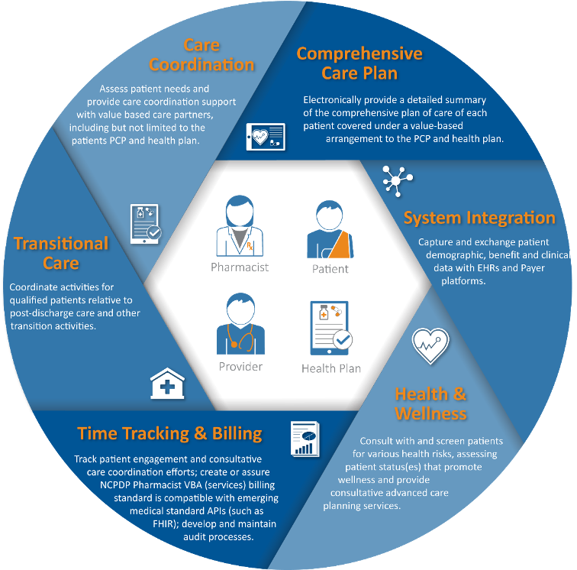
NCPDP July 2022 Stakeholder Action Group (SAG)
Cross Section of Healthcare, Pharmacy Industry
Open, consensus dialogue
Patient at the center of the discussions
Pharmacist involved VBAs (not competitive but complimentary of Primary Care Provider VBAs)
Areas of discussion
  Comprehensive care planning
  Pharmacy systems improvement and integration with medical EHRs
  Promote health and wellness
  Need for tracking and billing system (not all activity tied to dispensing medications)
  Encompass transitional care
  Complete care coordination to close gaps in care

Slide 26
Key Takeaways - NCPDP July SAG
YES – NCPDP Should Pursue these efforts
How are pharmacy management systems or vendors supporting VBAs today – is it on their roadmap?
Credentialing for Pharmacist is not consistent and should be addressed
Pharmacist provider status variability could be a challenge
Pharmacist can help minimize costs and close gaps in care as part of VBAs
Interoperability should be front and center – converge pharmacy and medical info sharing in real-time

Slide 27
Potential Pharmacist VBA Use Case
(CMS) Chronic Conditions Data Warehouse indicates that 27.5% of Medicare fee-for-service (FFS) beneficiaries had a diagnosis of diabetes in 2019
Objectives: Evaluate the ability of current NCPDP standard(s) to execute on sending certain patient, medication and encounter data to value-based arrangement (VBA) partners (i.e., primary care provider, payer/plan or their technical partner (intermediary, EHR, etc.). Understand the ability of NCPDP standard(s) to deliver, in real time, the VBA data to be consumed and acted upon by VBA partners but not associated with a claim, i.e., send the data only.
Design: Driven by payer VBA criteria, evaluate each data-element presently available in NCPDP standard(s), including but not limited to Telecommunication, SCRIPT, eCare Plan and any other relevant NCPDP standard that would capture clinical data elements based on given parameters for four pharmacy-payer VBA measurement areas:
A1c Control and Improvement
  Data needed to support the reporting and measurement of A1c Improvement and Control
    A1c Value Range – free text value or Code (CPT/HCPCS/SNOMED/LOINC)
    A1C Value Date
    NDC or RxNORM for medication received by the patient
    Date received
    ICD, CPT, HCPCS
Despite the importance of medication adherence, nonadherence to OAMs represents a substantial problem in the United States, with medication adherence rates ranging from 36% to 59% among elderly patients with diabetes.
Insulin is a lifesaving medication for all people with type 1 diabetes and many with type 2 diabetes. One in every three Medicare beneficiaries has diabetes, and more than 3.3 million Medicare beneficiaries use one or more of the common forms of insulin.
https://www.cms.gov/About-CMS/Agency-Information/OMH/Downloads/Data-Snapshots-Diabetes.pdf
https://www.jmcp.org/doi/pdf/10.18553/jmcp.2020.26.9.1099?download=true
https://diabetesjournals.org/care/article-abstract/45/8/1814/147083/Projected-Impact-of-the-Medicare-Part-D-Senior?redirectedFrom=fulltext

Slide 28
NCPDP Next Steps Post-SAG
Outreach and survey to pharmacy management systems and vendor organizations regarding the interoperability roadmaps to support pharmacist access, use and exchange of clinical data and billing for clinical services
Continue working with NCPDP member – adding to current standards and promoting adoption or determine if a wholly new standard is needed
Promote Use Case Execution – Possibly through NCPDP Foundation
NCPDP Leadership to communicate and collaborate with industry stakeholders on the issue of Pharmacist Credentialing and recognition of credentialing in VBAs
Continue working with measurement development organizations to create meaningful pharmacist specific measures for quality care and closing gaps in care

Slide 29
Measuring Success
NCPDP continues to focus on current and future quality measurements that are used in measuring value in healthcare
Most measures address - Effectiveness and efficiency; Timeliness; and Safety
We will evaluate and execute on a strategy for our standards to support current and future measures
  Such as Equity – a prime strategic focus for CMS
Much of our efforts to date have been on current CMS and Pharmacy Quality Alliance (PQA) Measures

Slide 30

Meaningful Measures
Goals of CMS’ Meaningful Measures 2.0
CMS Final Rule (4190-F2) - Contract Year 2022 Medicare Advantage and Part D Final Rule (January 1, 2021)
Starting January 1, 2022, CMS is requiring Part D plans to disclose pharmacy performance measures to CMS
Enable CMS to:
  Better understand how such measures are applied
  Report pharmacy measures publicly
  Increase transparency on the process
  Inform the industry in its new efforts to develop a standard set of pharmacy performance measures.
https://www.cms.gov/medicare/meaningful-measures-framework/meaningful-measures-20-moving-measure-reduction-modernization

Slide 31
PQA - CMS Rationale on Publishing Pharmacy Performance Measures
Utilize only quality measures of highest value and impact focused on outcomes of key quality domains​
Align measures across value-based programs and across partners, including CMS, federal and private entities​
Engage patients through transparency, patient centered measures, and patient reported outcomes​
Transform measures to fully-digital by 2025, and incorporate all-payer data​
Develop and implement measures that reflect social and economic determinants​
Publishing pharmacy performance measures will promote development of consensus-built standards by industry that are transparent and equitable across various pharmacy types and patient populations, and support value-based care.

Slide 32
PQA Pharmacy Measure Set
Proportion of Days Covered: Renin Angiotensin System Antagonists (Pharmacy) (PDC-RASA-PH)
Proportion of Days Covered: Statins (Pharmacy)
(PDC-STA-PH)
Proportion of Days Covered: Antiretroviral Medications (Pharmacy)
(PDC-ARV-PH)
Primary Medication Nonadherence
(PMN)
Medication Synchronization: Program Acceptance and Initial Synchronization (QII)
Medication Synchronization: Patient Contact Rate (QII)
Medication Synchronization: Completeness (QII)
Medication Synchronization: Continuation: 2 Rates (QII)
https://www.pqaalliance.org/pqa-measures

Slide 33
How to Get Involved
Talk to your Pharmacist
Promote Pharmacist ability to practice at the top of their license and be reimbursed for clinical services - https://actioncenter.pharmacist.com/campaign/provider-status-for-pharmacists/
Become an NCPDP member - https://www.ncpdp.org/membership.aspx
Improve interoperability with a lens toward all stakeholders, including pharmacists/pharmacies
Encourage Patient Empowerment

Slide 34



CPE INSTRUCTIONS (On-Demand Version):
Expanding Pharmacists’ Participation in Value-Based Arrangements (VBAs): A Look at NCPDP Standards & its VBA
1
2
3
1
Redeem your credit online at
CEimpact.com
*If this is the first time you have utilized the CEimpact Learning Management System (LMS) you will need to create an account.
From the CEimpact.com Homepage – enter the code provided in the ‘Enter Code’ box and click SUBMIT.
Complete the Exam & Evaluation as prompted; click SUBMIT to send your information to CPE Monitor. Follow instructions to access your CPE Statement of Credit on CPE Monitor.
Click on My Courses. Then click on the Course Title in your Enrolled folder. Read the course instructions.
Pharmacist Code: g5Cunr
Technician Code: kfcMCL
The deadline for obtaining your CPE Credit is 9/27/2025.
The deadline is non-negotiable due to CPE Monitor reporting policies.

Slide 35
Questions?

Slide 36
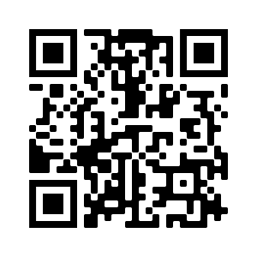
UPCOMING WEBINARS:
NCPDP Webinar: New Legal Hurdles in the Pharmacy Industry: A Legal Update October 13, 12:00 p.m. ET Fee: $50 Members; $150 Non-Members
NCPDP Webinar: Introduction to Digital Therapeutics October 18, 12:00 p.m. ET Fee: $50 Members; $150 Non-Members
NCPDP Webinar: Expanding Into Home-Based Services to Increase Revenue October 25, 12:00 p.m. ET Fee: $50 Members; $150 Non-Members
https://www.ncpdp.org/Webinars.aspx
36

Slide 37
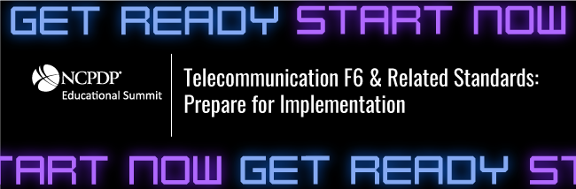
NCPDP 2022 Virtual Educational Summit
November 15 & 16
- Registration Now Open! -
Learn more & register! ncpdp.org/Educational-Summit.aspx
37

Slide 38

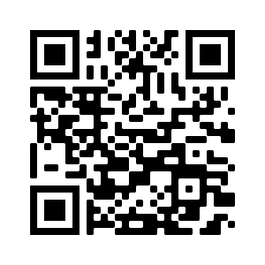
Call for Proposals for #NCPDP23,
“The Great Race to Close Gaps in Care” is Open until October 4th!
View suggested topics and submit a proposal today: https://ncpdp.org/AC/call-for-proposals-info.aspx
38

Slide 39

SAVE THE DATE!
HIMSS23 Global Conference
April 17-21, 2023 | Chicago, IL
Call for Posters now open through November 28, 2022 ​
https://www.himss.org/global-conference/program-special-forums​
Registration is open!!​
https://www.himss.org/global-conference/registration-info-pricing ​

Slide 40

Thank you.
Contact Gwynne Jelbaoui gwynne.jelbaoui@himss.org
312-638-9490

