Slide 1

HIMSS Innovation Community Webinar
The event will begin shortly.
Visit the HIMSS Innovation Community at https://www.himss.org/membership-participation/innovation
December 3, 2020

Slide 2



Welcome
Notes:
Welcome everyone to our webinar event, I am Ian Hoffberg, a manager on our thought advisory team here at HIMSS and I will be our moderator today. I first want to thank our HIMSS20 Artificial Intelligence & Machine Learning Circle sponsor Palantir. Who focus on creating the world’s best user experience for working with data, one that empowers people to ask and answer complex questions without requiring them to master querying languages, statistical modeling, or the command line. They achieve this by building platforms for integrating, managing, and securing data on top of which we layer applications for fully interactive human-driven, machine-assisted analysis.

Slide 3
The National COVID Cohort Collaborative (N3C):
Revealing the Secrets of COVID-19

Slide 4
Agenda
Welcome
HIMSS Innovation Community Updates / Announcements
Presentation:
  The National Covid Cohort Collaborative:
  Revealing the secrets of COVID-19Live Q&A
Wrap-Up / Next Steps

Slide 5

Updates and Announcements

Slide 6

2021 HIMSS Global Health Conference & Exhibition
August 9-13, 2020 | Las Vegas
Experience education from world-class speakers, the latest innovations in health and IT products, plus powerful 1:1 networking.
https://www.himssconference.org/
Notes:
HIMSS Global Health Conference & Exhibition brings you the world-class education, cutting-edge products and solutions, and unique networking opportunities you need to solve your biggest health information and technology challenges – all at one time, all in one place.

Slide 7

The 2020 HIMSS Cybersecurity Survey provides insight into the cybersecurity landscape of US healthcare organizations based upon the feedback from 168 US based healthcare cybersecurity professionals.
https://www.himss.org/resources/himss-healthcare-cybersecurity-survey
Notes:
Healthcare organizations face a barrage of significant security incidents such as phishing, ransomware, and social engineering attacks, in addition to the challenges faced by dealing with the COVID-19 pandemic.

Slide 8


Welcome
Melissa Haendel
Director Center for Data to Health
Co-lead, N3C
Chris Chute
CRIO Johns Hopkins
Co-lead, N3C
Co-PI, Center for Data to Health
Anita Walden
Assistant Director
Center for Data to Health (CD2H/N3C)
Notes:
Dr. Melissa Haendel - is the Director of the Center for Data to Health (CD2H) at Oregon Health & Science University, the Director of Translational Data Science at Oregon State University, and an elected Fellow of the American Medical Informatics Association. Her background is in translational science, with a focus over the past decade on the development of ontologies, semantic engineering technologies, and open science infrastructure programs. Dr. Haendel’s vision is to weave together healthcare systems, basic science research, and patient generated data through development of data integration technologies and innovative data capture strategies.
Dr. Christopher Chute - is the Bloomberg Distinguished Professor of Health Informatics, Professor of Medicine, Public Health, and Nursing at Johns Hopkins University, and Chief Research Information Officer for Johns Hopkins Medicine. Board Certified in Internal Medicine and Clinical Informatics, and an elected Fellow of the American College of Physicians, the American College of Epidemiology, HL7, the American Medical Informatics Association, and the American College of Medical Informatics (ACMI), as well as a Founding Fellow of the International Academy of Health Sciences Informatics. His career has focused on how we can represent clinical information to support analyses and inferencing, including comparative effectiveness analyses, decision support, best evidence discovery, and translational research.
Ms. Anita Walden - Assistant Director of the National Center for Data to Health at Oregon Health & Science University, has a background in biomedical informatics and clinical trials. She has managed community and global data operations for large scale trials conducted in over 25 countries and with a focus on streamlining research activities, patient-centered engagement, and access to clinical trials. Her informatics background is diverse, with experience in digital health technology, international data standards development, data integration, usability evaluation, and electronic health record interoperability. She has held leadership roles in Health Level Seven (HL7) and the Critical Path Institute, and has a strong relationship with the Clinical Data Interchange Consortium (CDISC), collaborating on standards methodology activities. She is also an industry educator and trainer in clinical research informatics, and mobile health technologies with the Society of Clinical Data Management (SCDM).

Slide 9


The National COVID Cohort Collaborative (N3C): Revealing the Secrets of COVID-19
Updates from the NIH National COVID Cohort Collaborative:
HIMSS Presentation
December 3, 2020
@data2health
@ncats_nih_gov
@ontowonka
covid.cd2h.org ncats.nih.gov/n3c
Notes:
Anita

Slide 10


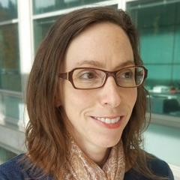
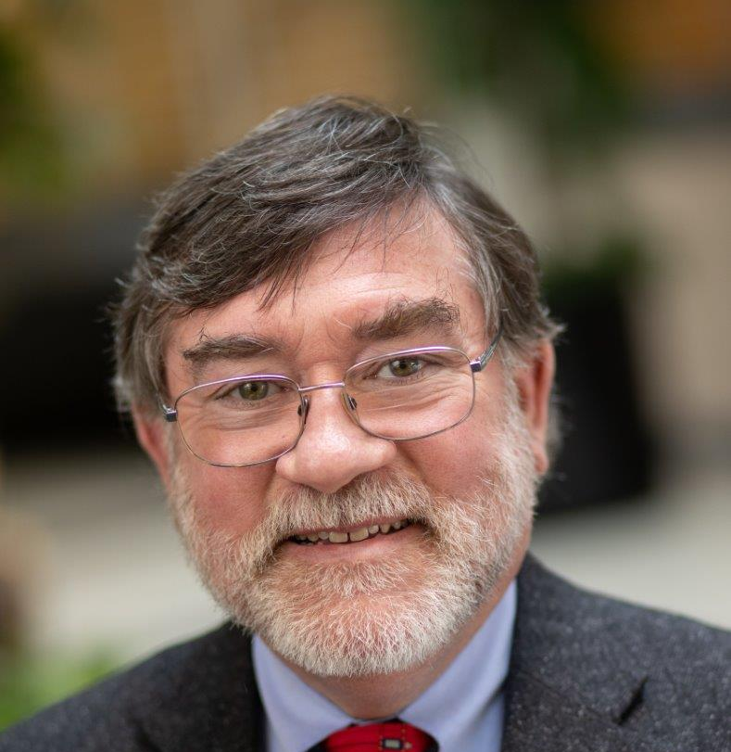
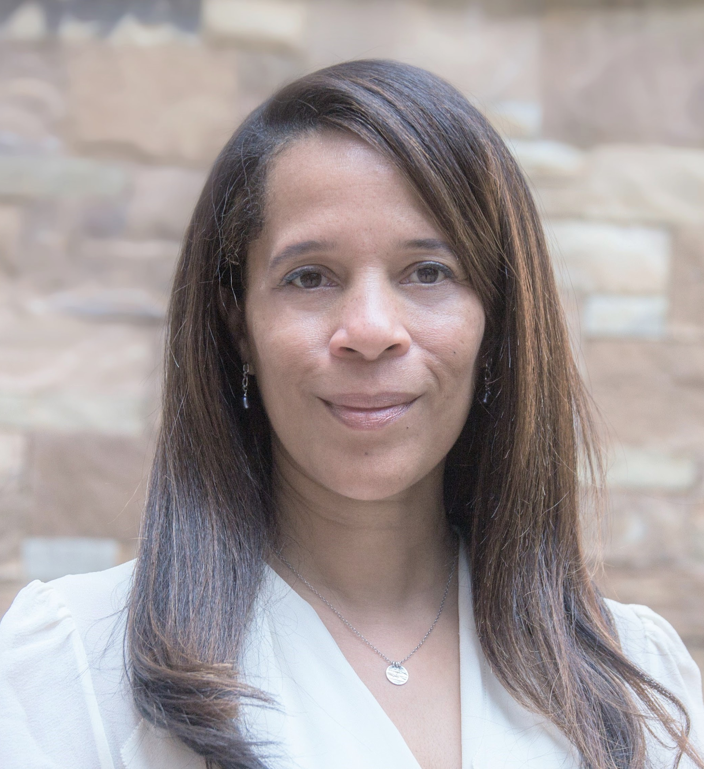
Panelist & Objectives
Informatics and regulatory challenges
The scope of answerable questions
Data access and security
Melissa Haendel
Director Center for Data to Health
Co-lead, N3C
Chris Chute
CRIO Johns Hopkins
Co-lead, N3C
Co-PI, Center for Data to Health
Enclave statistics
How common data models and variables are harmonized
Anita Walden
Assistant Director
Center for Data to Health (CD2H/N3C)
Collaborative science in N3C
User access and getting involved
Notes:
Understand the informatics and regulatory challenges of establishing a large-scale collection of centralized EHR data.
Articulate the common data models used as source data for N3C integration and how they are harmonized in the project.
Describe the N3C data enclave—both from a security/confidentially projection perspective and as an analytics-driven environment.
Understand the scope of questions answerable with the N3C data and machine learning methods.

Slide 11

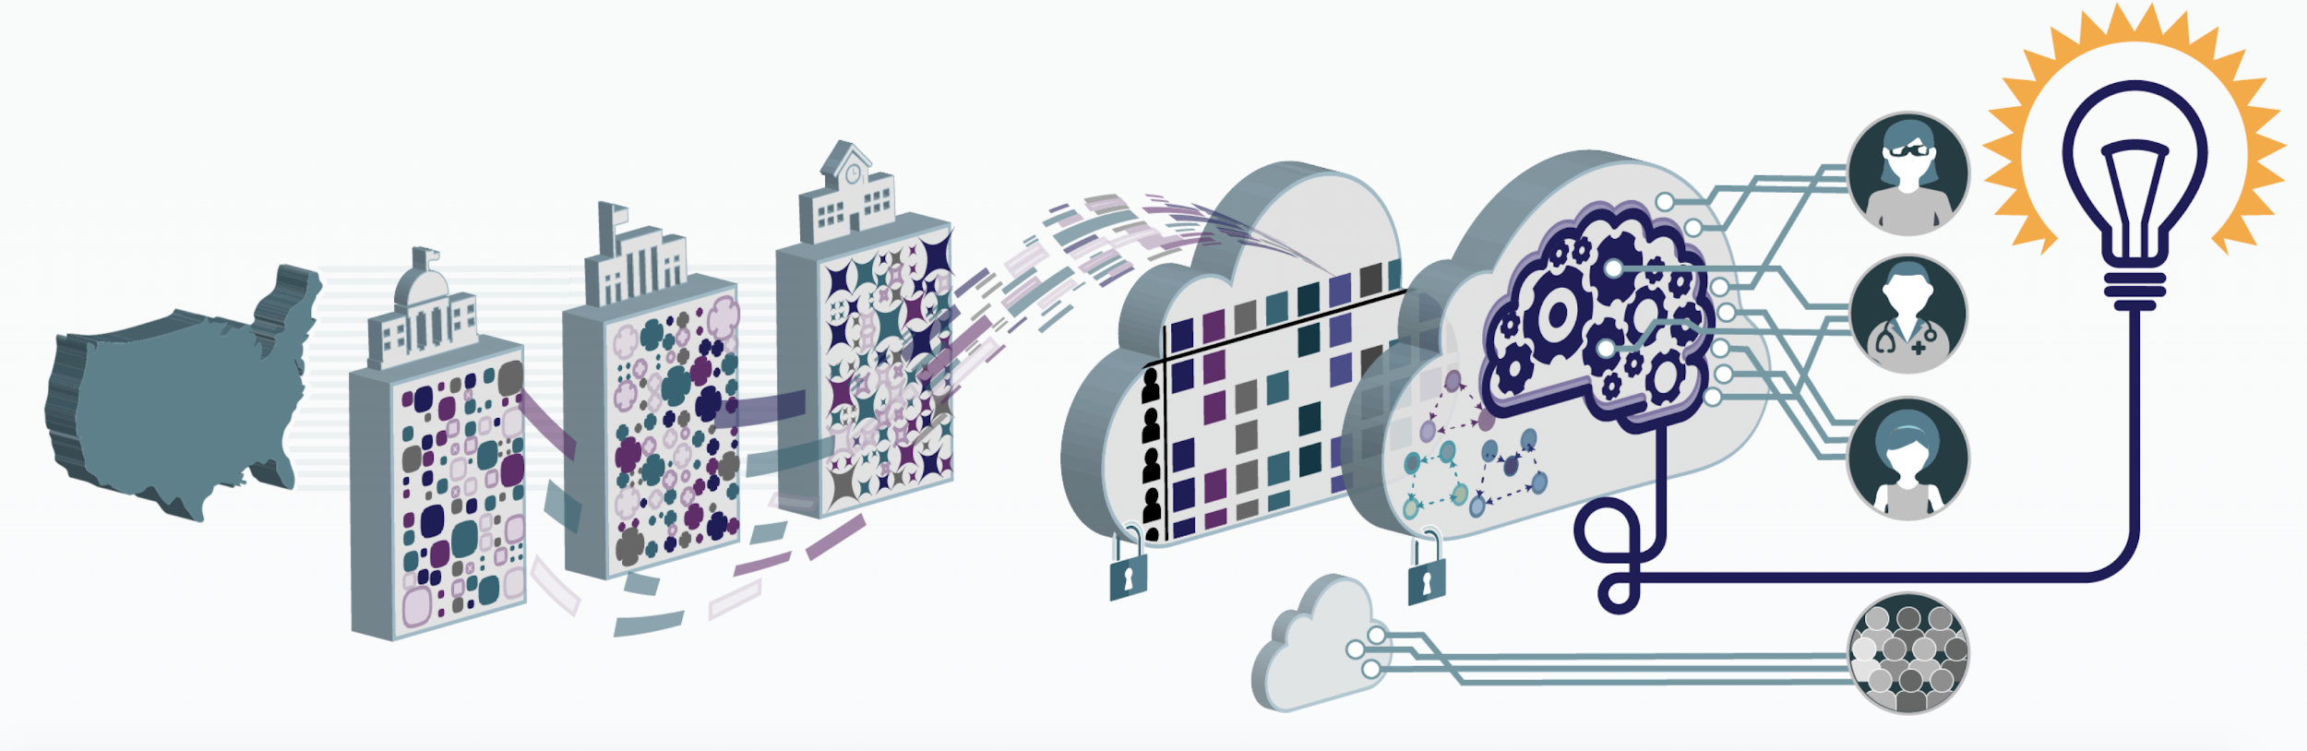




Clinical and Translational Science Awards (CTSA) Program

Slide 12
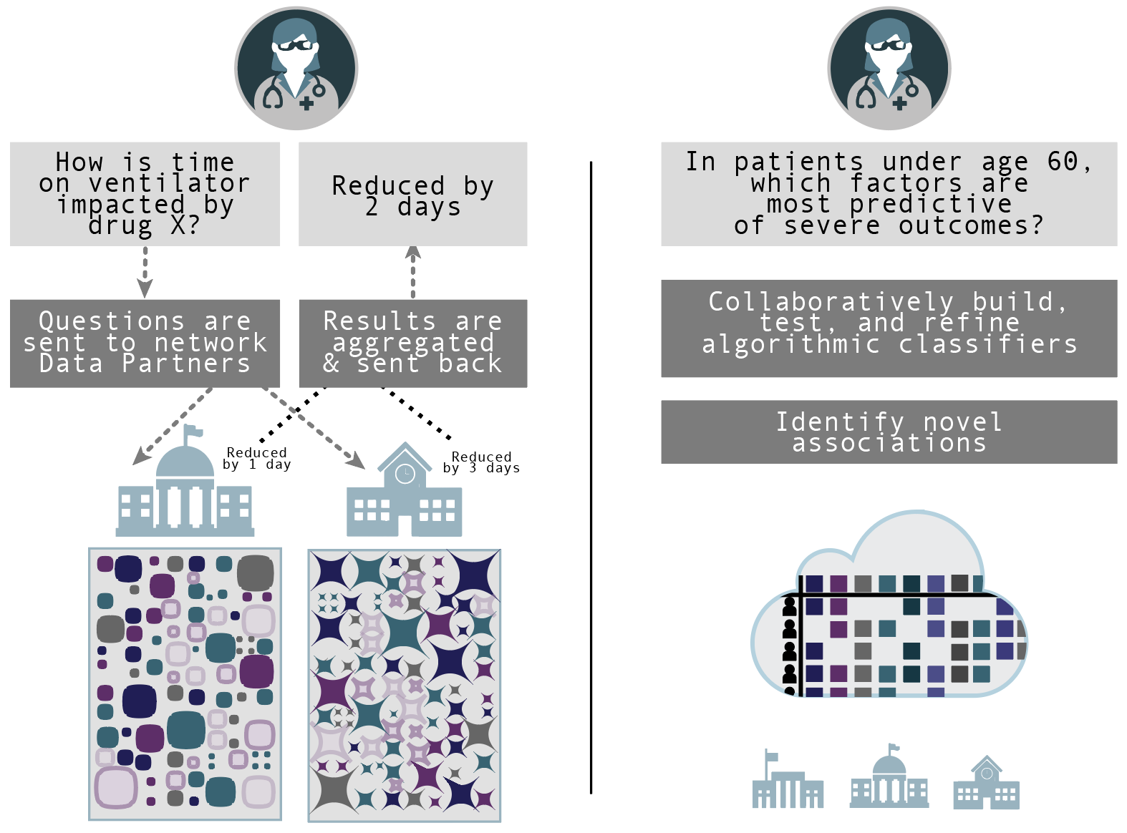


Federated
querying
Centralized analytics
Centralizing patient-level data makes it possible to ask different and more powerful questions than in federated contexts
Such networks are key to quickly build a centralized dataset
Data resides locally
Data resides centrally in a secure enclave
N3C
cloud
Notes:
Does Disease Y impair course?
Does an income > $50,000 per year improve outcomes?
What Drugs help covid-19 patients, and which hinder?
What Diagnoses impact outcome?
What Social Determinants impact course and outcome?

Slide 13
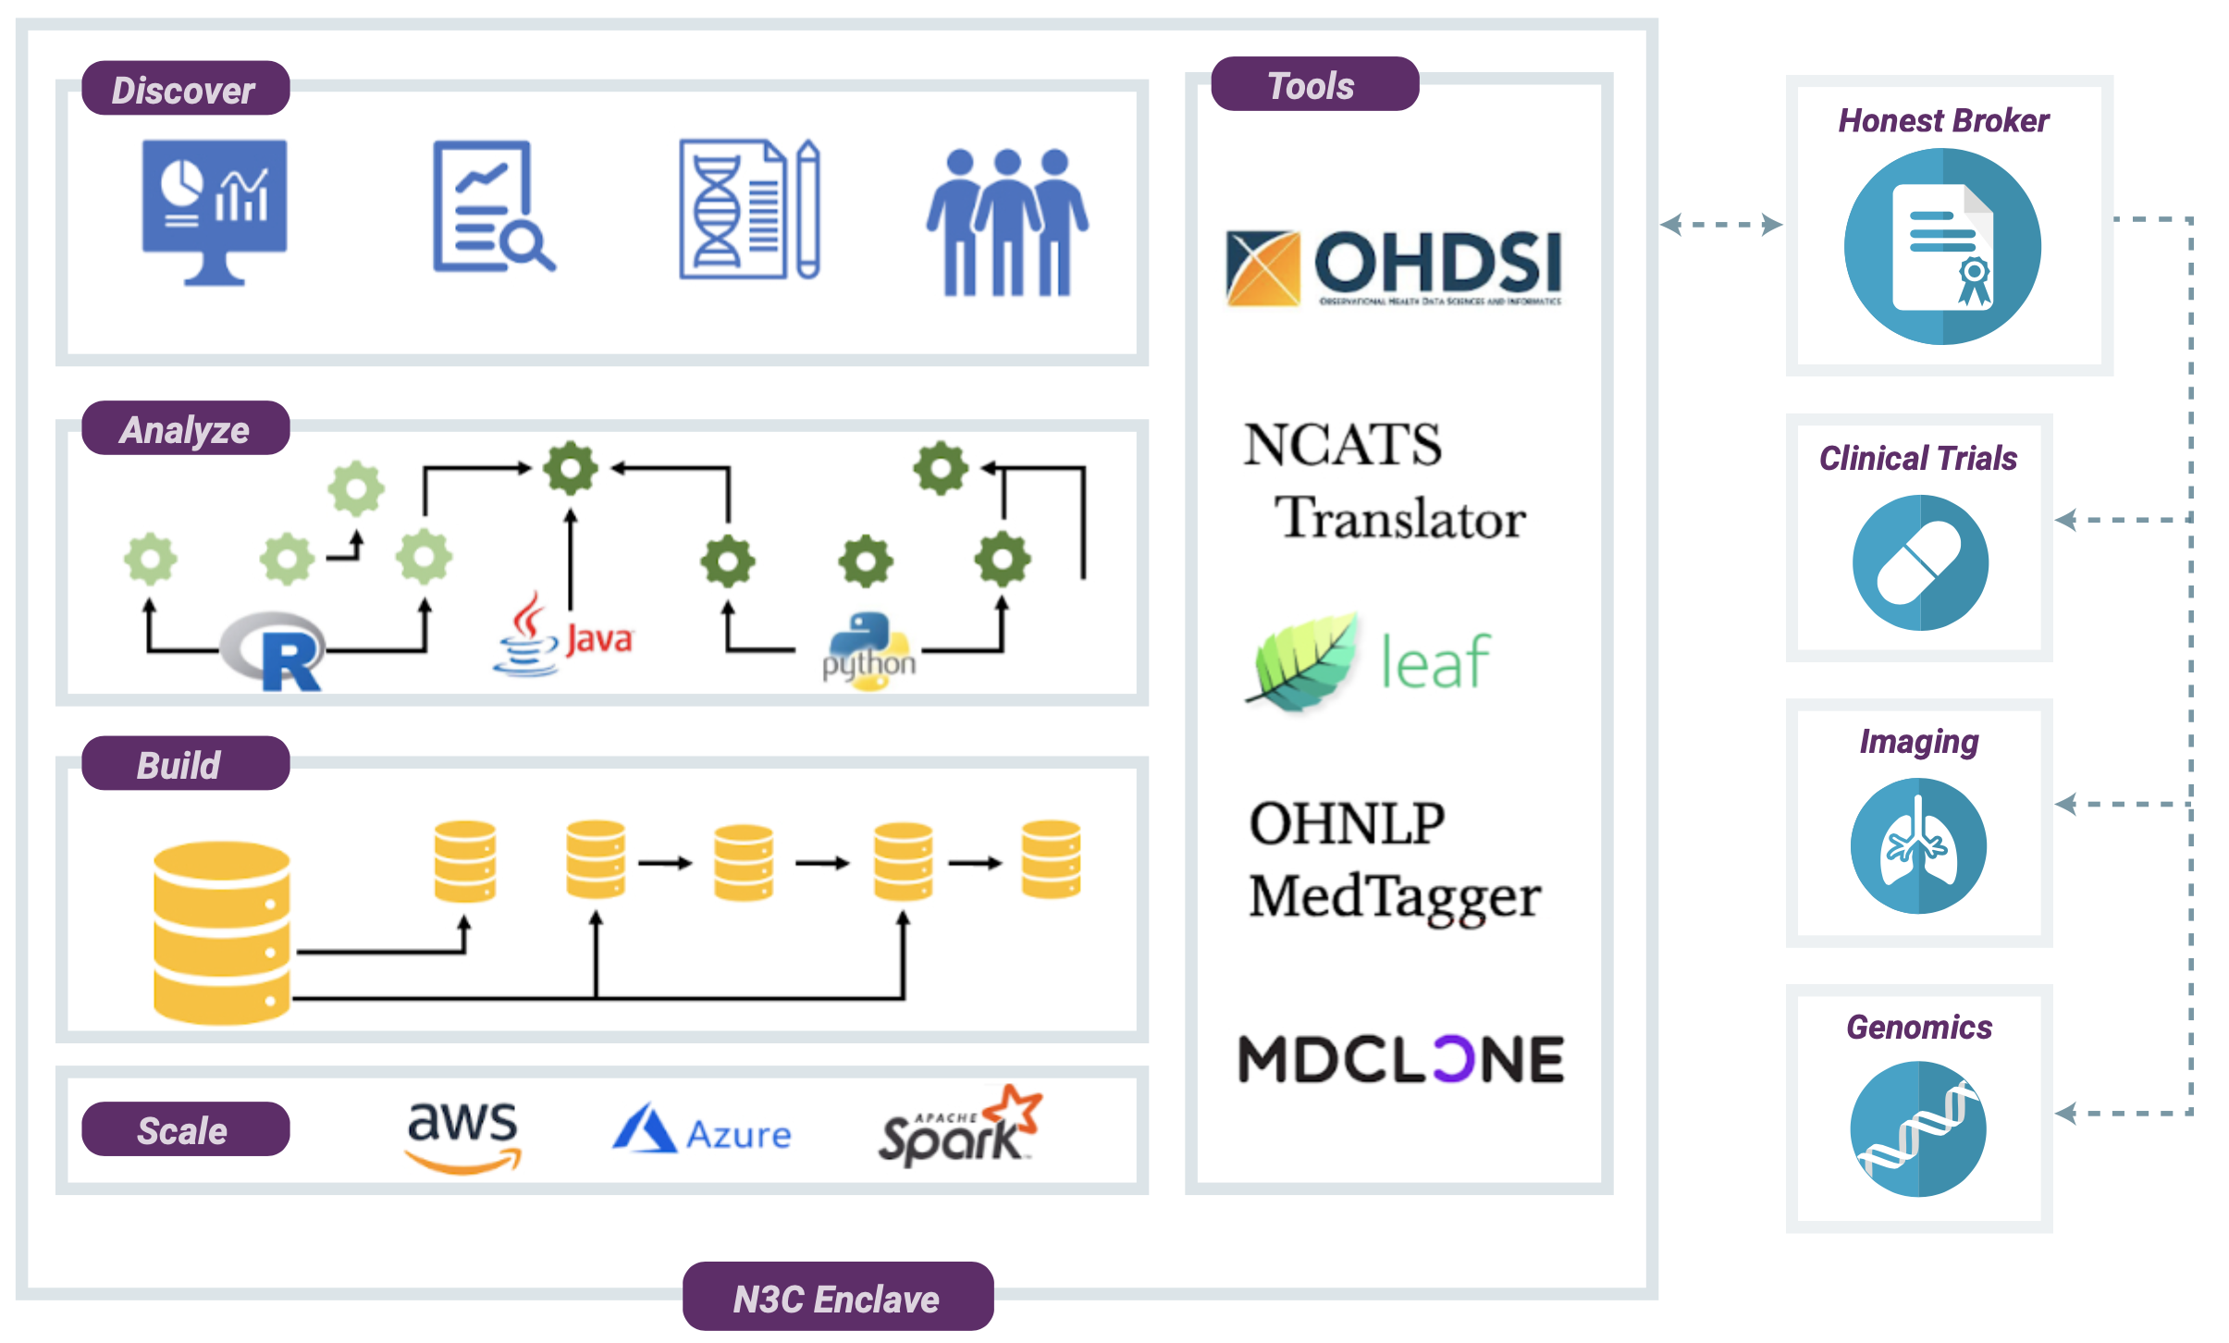
Collaborative Analytics - N3C Secure Data Enclave
Secure, reproducible, transparent, versioned, provenanced, attributed, and shareable analytics on patient-level EHR data

Slide 14

What Kinds of Questions Can N3C Address?
The scope and scale of the information in the N3C Data Enclave will support probing questions such as:
Do some therapies work better than others? Regionally? Demographically?
Can we predict who with COVID-19 might have severe outcomes?
Can we predicate acute renal failure in COVID-19 patients?
Who might need a ventilator because of lung failure?
Why are some people asymptomatic?
Can we compare rates of infectivity within school-aged children prior to school reopening and after?
Which social determinants of health are risk factors for mortality?
Notes:
Anita

Slide 15

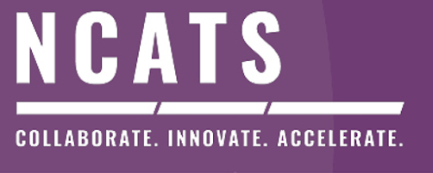

Governing N3C Data

Slide 16

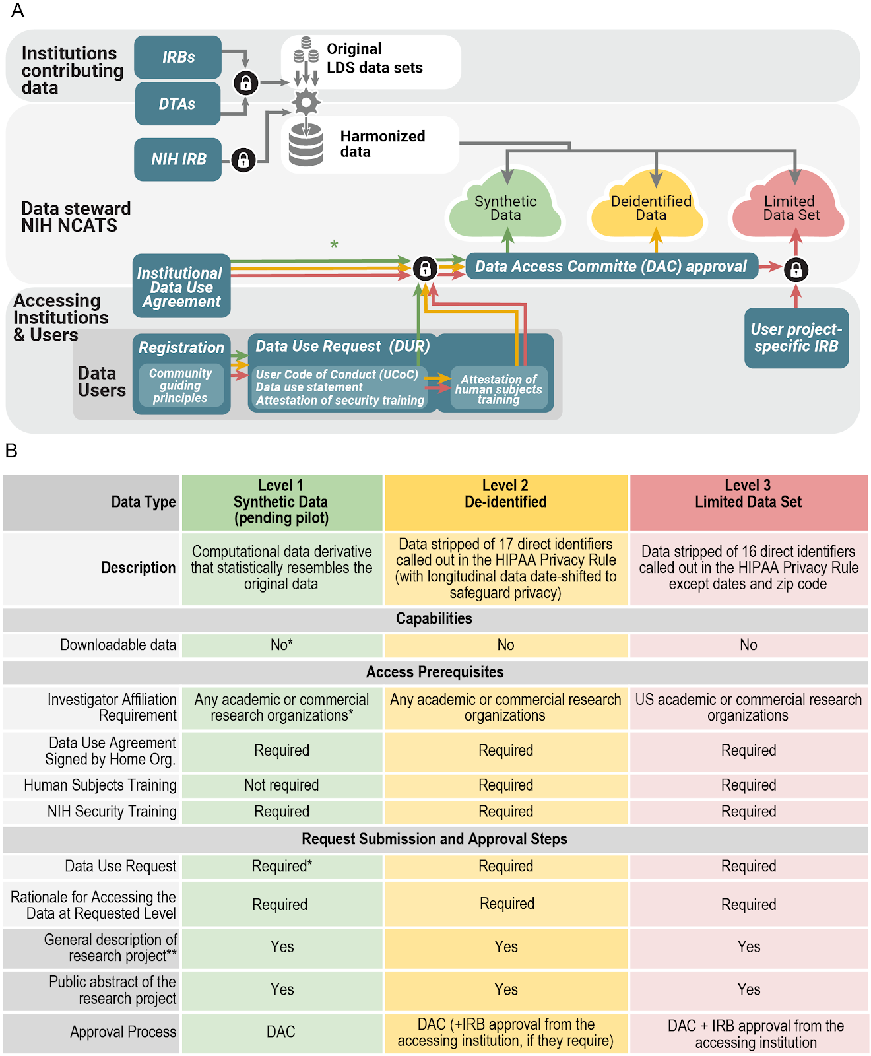
Data Levels to Access
Notes:
Nicole Garbarini

Slide 17

Data Use and Privacy
Goal of the Data Use Agreement is Privacy Protection to Promote broad access:
COVID-Related research only
No re-identification of individuals or data source
No download or capture of raw data
Open platform to all researchers
Security: Activities in the N3C Data Enclave are recorded and can be audited
Disclosure of research results to the N3C Data Enclave for the public good
Analytics provenance
Contributor Attribution tracking

Slide 18
N3C: Governance and Access
Notes:
Nicole Garbarini

Slide 19
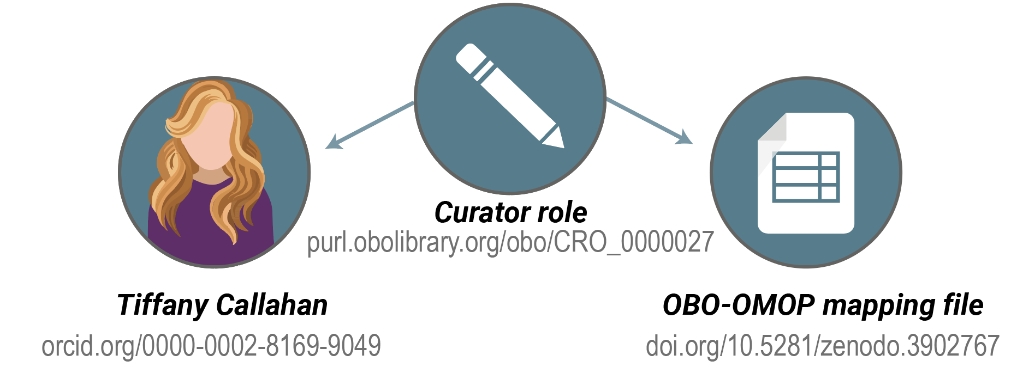
N3C Provenance, Transparency,
Attribution & Rapid Sharing
N3C Attribution and Publication Principles v1.3
Transparent and collaborative environment where all contributions are acknowledged
Provenance and reproducibility
Promptly sharing research results with N3C users
Publish in high-impact journals
Attribution for all N3C artifacts
Researchers, projects, and artifacts are all linked together in the enclave using the Contributor Attribution Model (CAM).
Notes:
The N3C Collaborative analytics platform will support robust tracking of provenance and attribution; the DUA will require attribution of all scientific outcomes to everyone who contributed.
cd2h.org/attribution

Slide 20
Data Transfer Agreement Signatories
12/1/2020
73 DTA Signatories
Northwestern University at Chicago ᛫ Tufts Medical Center ᛫ Advocate Health Care Network ᛫ University of Alabama at Birmingham ᛫ Oregon Health & Science University ᛫ University of Washington ᛫ Stanford University ᛫ The University of Michigan at Ann Arbor ᛫ Children's Hospital Colorado ᛫ Duke University ᛫ Medical College of Wisconsin ᛫ The Ohio State University ᛫ University of Nebraska Medical Center ᛫ University of Arkansas for Medical Sciences ᛫ George Washington University ᛫ Johns Hopkins University ᛫ West Virginia University ᛫ Medical University of South Carolina ᛫ University of North Carolina at Chapel Hill ᛫ University of Virginia ᛫ The University of Texas Medical Branch at Galveston ᛫ University of Minnesota ᛫ University of Cincinnati ᛫ Columbia University Irving Medical Center ᛫ Cincinnati Children's Hospital Medical Center ᛫ Rush University Medical Center ᛫ Nemours ᛫ University of Wisconsin-Madison ᛫ The State University of New York at Buffalo ᛫ Washington University in St. Louis ᛫ University of Rochester ᛫ The University of Chicago ᛫ University of Miami ᛫ The Scripps Research Institute ᛫ University of Texas Health Science Center at San Antonio ᛫ University of Kentucky ᛫ University of Illinois at Chicago ᛫ Virginia Commonwealth University ᛫ Weill Medical College of Cornell University ᛫ Carilion Clinic ᛫ University Medical Center New Orleans ᛫ The University of Iowa ᛫ Emory University ᛫ Maine Medical Center ᛫ The University of Texas Health Science Center at Houston ᛫ Boston University Medical Campus ᛫ The University of Utah ᛫ University of Southern California ᛫ George Washington Children's Research Institute ᛫ University of Colorado Denver I Anschutz Medical Campus ᛫ Mayo Clinic Rochester ᛫ The Rockefeller University ᛫ Montefiore Medical Center ᛫ University of Mississippi Medical Center ᛫ University of Oklahoma Health Sciences Center, Board of Regents ᛫ University of Massachusetts Medical School Worcester ᛫ Aurora Health Care ᛫ Penn State ᛫ University of New Mexico Health Sciences Center ᛫ NorthShore University HealthSystem ᛫ Wake Forest University Health Sciences ᛫ Vanderbilt University Medical Center ᛫ Regenstrief Institute ᛫ Brown University ᛫ Stony Brook University ᛫ University of California, Davis ᛫ Yale New Haven Hospital ᛫ Rutgers, The State University of New Jersey ᛫ MedStar Health Research Institute ᛫ Loyola University Chicago ᛫ Loyola University Medical Center ᛫ University of Delaware ᛫ Children's Hospital of Philadelphia
https://ncats.nih.gov/n3c/resources/data-contribution/data-transfer-agreement-signatories

Slide 21

N3C Cohort

Slide 22
Cohort characterization objectives
Clinically characterize the N3C cohort
Largest U.S. COVID-19 cohort to date (+ representative controls)
Racially, ethnically, and geographically diverse
Develop and share validated, versioned OMOP representations of common variables (labs, vital signs, medications, treatments)
Generate hypotheses to be tested in N3C and elsewhere
Clinical phenotypes and trajectories
Treatment patterns and response
… and many others
+
?

Slide 23
N3C Progress
Official launch
Sept 2
Enclave Data Today:
2 Billion rows of data
2 Million Patients
247,822 COVID+ Patients
72 Data Transfer Agreements Executed
58 Projects
31 Released Sites
Key capabilities
First DUR approved
Sept 15
First DUA & Soft launch
August 17
Phenotype 1.0
April 20
JHM central IRB
May 1
1st data ingest
May 12
1st accepted Manuscript
July 29
1st DTA signed
May 1
12/2/2020
1220 individual members affiliated with 310 organizations, 49 states in the US, and 15 foreign countries. 69 of institutions are US clinical hubs (119 including affiliates).
DTA Finalized
April 27
Key metrics
CDM complete
June 22
AMIA webinar
April 13
Austin town hall
May 8
Buse presentation & SC brainstorm
October 9
Key catalysts
Buse letter to SC
April 26

Slide 24
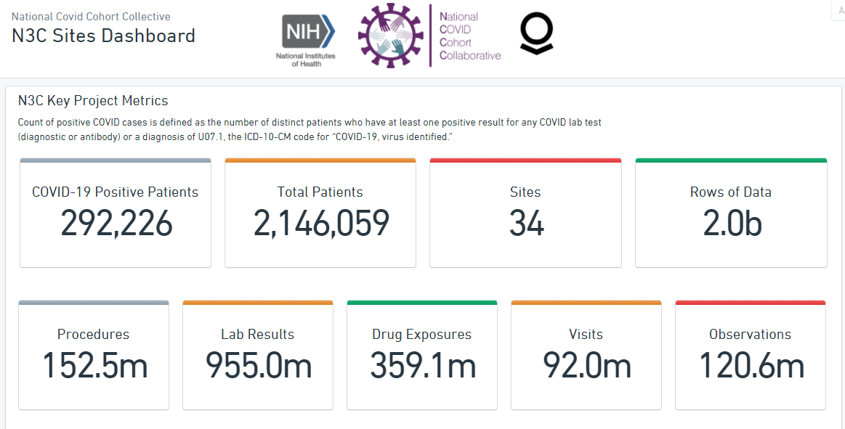
Enclave Statistics

Slide 25
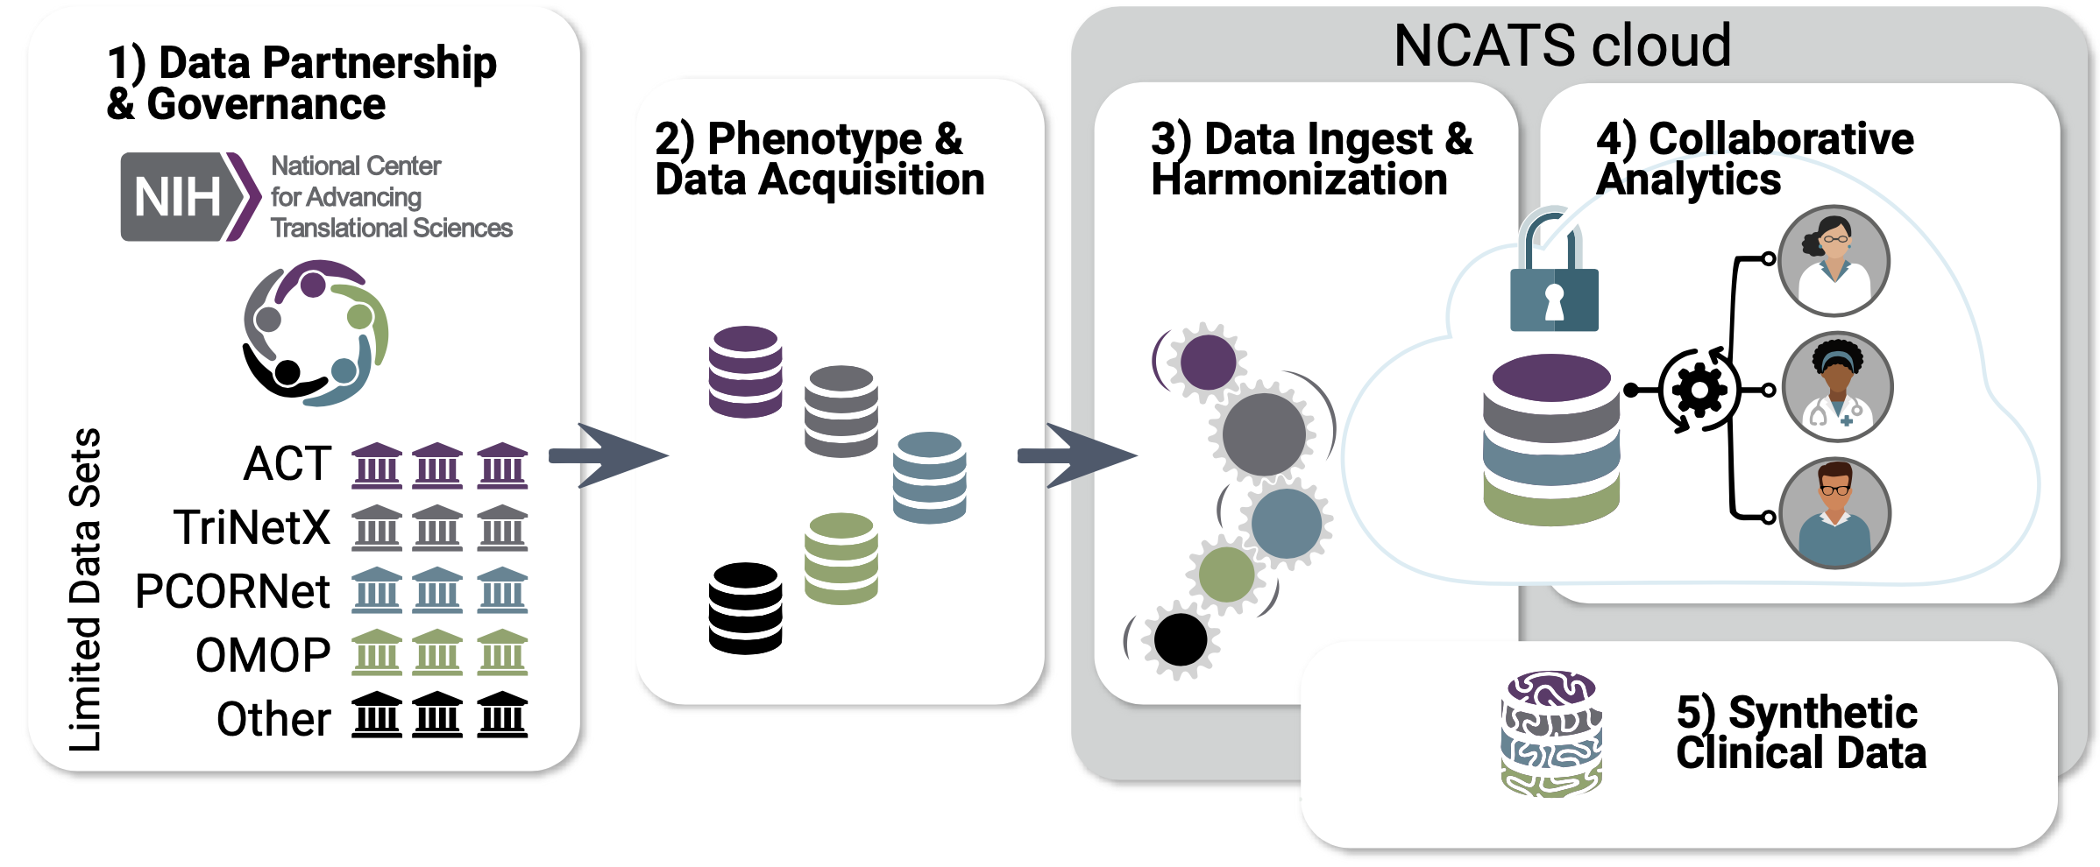
Major workstreams of the
National COVID Cohort Collaborative

Slide 26


N3C Data Harmonization
Hospital A
Hospital B
PATIENT_ID | DIAGNOSIS_ID | DIAGNOSIS_ DATE
12345 | 7298374 | 6/1/2020
PATIENT_ID | DIAGNOSIS_CD | DIAGNOSIS_ DATE
6789 | U07.1 | 2020-07-04
These patients both have COVID diagnoses; but a single query won't capture both of them.
Versioned data from all sources is combined into a target model (OMOP)

Slide 27
Variable and concept set validation
N3C Data Harmonization
Creatinine in urine is included with blood/serum levels
Ingested data
Unit harmonization
Domain tables
(person, visit, time, concept, value, unit)
No creatinine from site XXX
Quality Control visualizations
Code set definition in Atlas
Code set definition in N3C enclave
Mass/volume
Mixed with molarity
8/31: 36 Variable code sets ‘version 1.0’
Data element curation

Slide 28
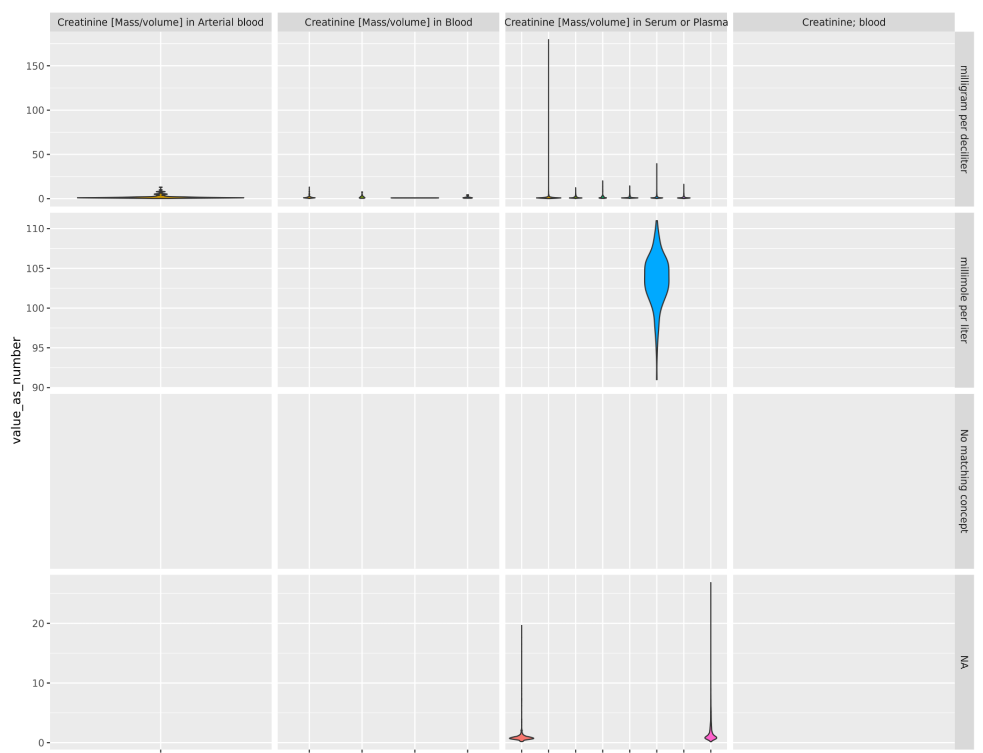
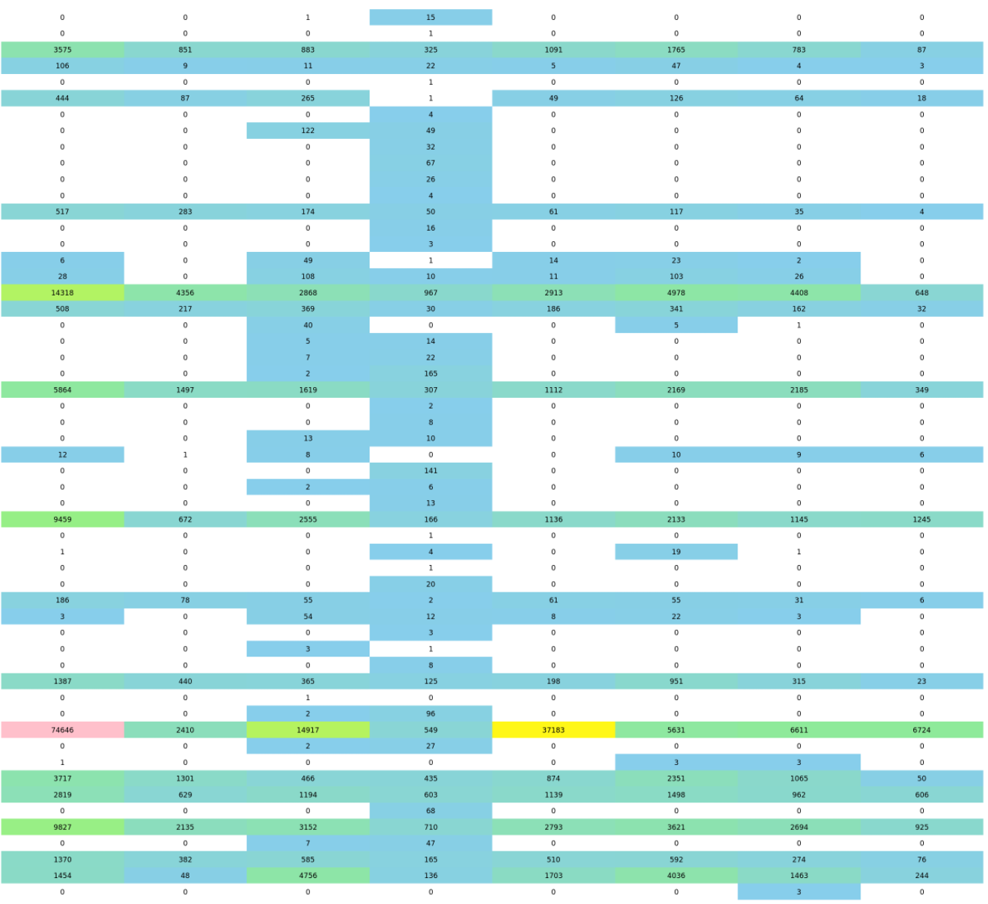
Creatinine: units & lab code usage
Asthma: code usage across sites
N3C Data Harmonization
Data element curation

Slide 29
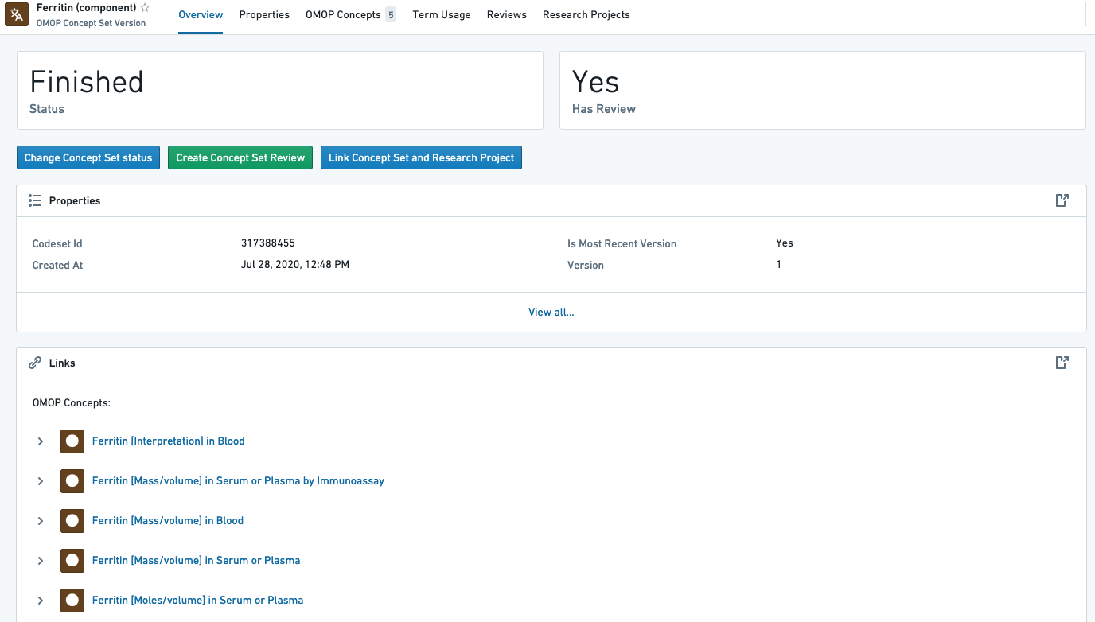

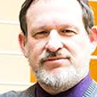
Developing Common MetaVariables
Ben Amor Palantir
Harold Lehmann
Johns Hopkins

Slide 30
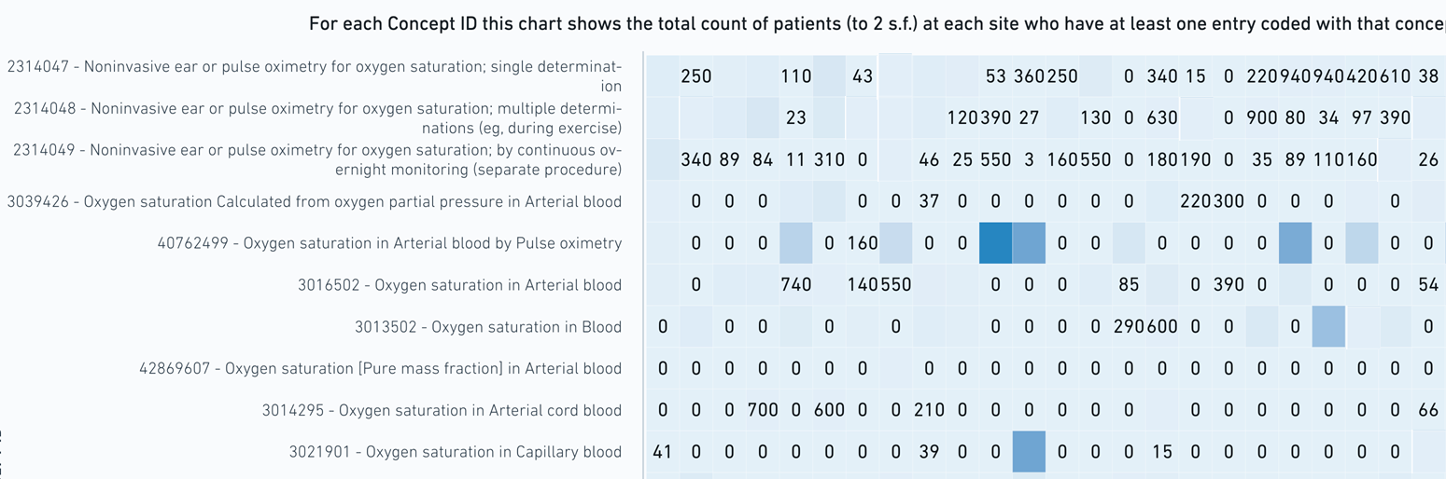
Source Variable Harmonization
Pulse Oximetry Variation

Slide 31

MetaVariable Scope
11/18/2020
201 Variables with harmonized quantitative units of measure
5 Variables with harmonized qualitative results (COVID lab concepts only) Variable templates (BMI, macro-visits)
619 Concept sets under construction (labs, diagnoses, conditions, events, treatment)
25 Creators 10 Projects
532,2080 Concept ids
134 Variables for the Cohort Paper

Slide 32

Realizing Team Science
Notes:
https://www.123rf.com/photo_134343806_team-thinking-together-as-a-diverse-group-of-people-coming-together-joining-hands-into-the-shape-of-.html

Slide 33

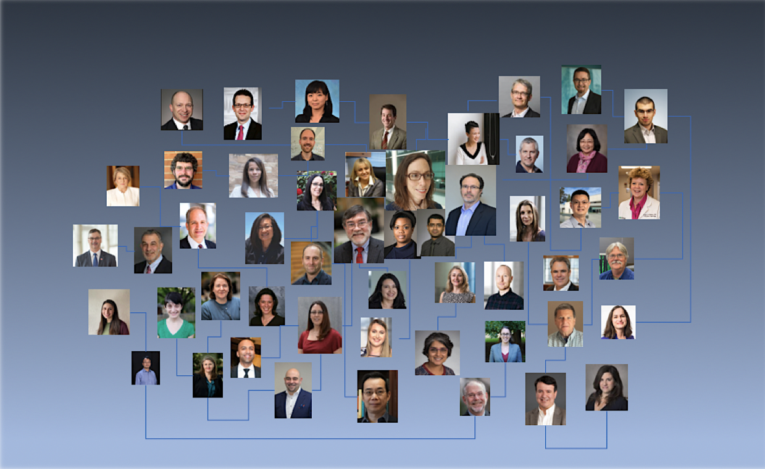
N3C Team Science
Key functions can nucleate projects:
Education & training
Biostatistics
Study design
Evaluation
Informatics
Clinical expertise
Innovation & commercialization
Community & partnerships
N3C Domain Team Expertise:
Enclave technology
Data model (OMOP)
Terminologies
Data quality
Codesets, variables, phenotype
Using/parsing N3C data
Workflows, methods, algorithms
covid.cd2h.org/Domain_Teams
Notes:
Image: https://beasleydirect.com/boost-regional-results-local-search-marketing/

Slide 34

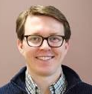
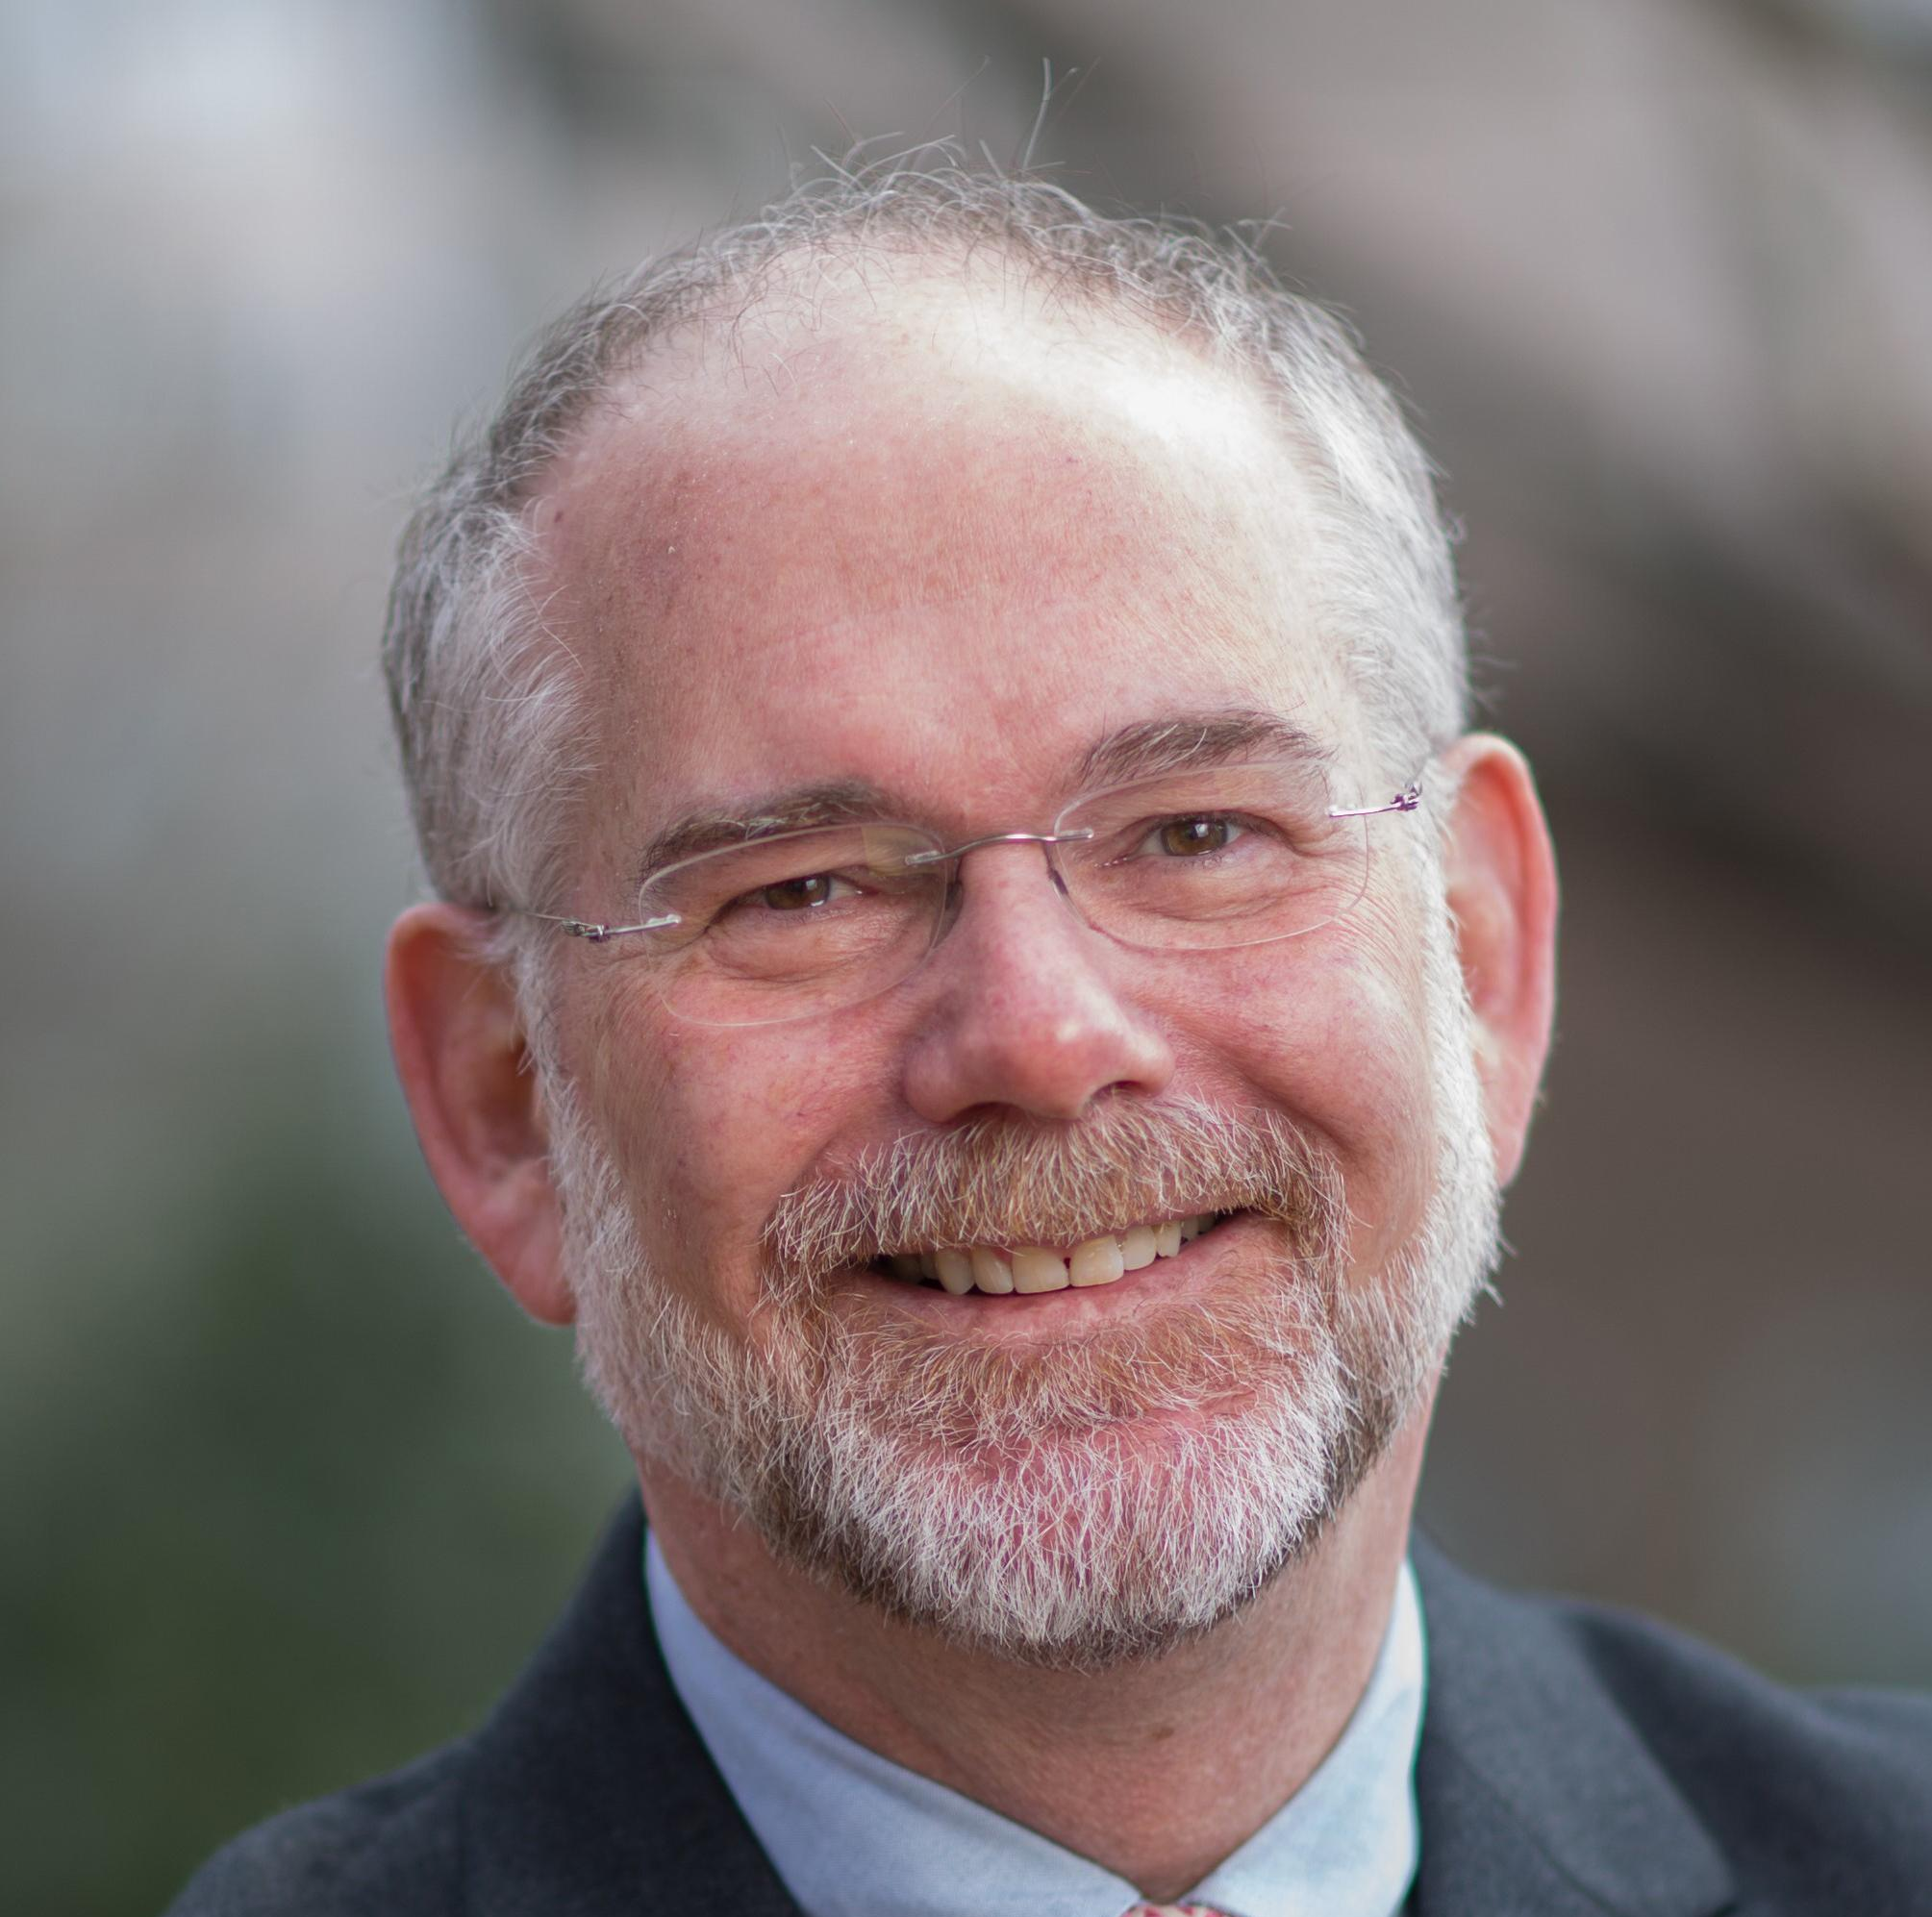
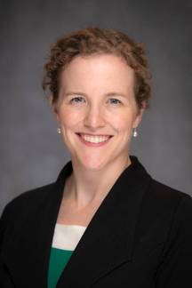
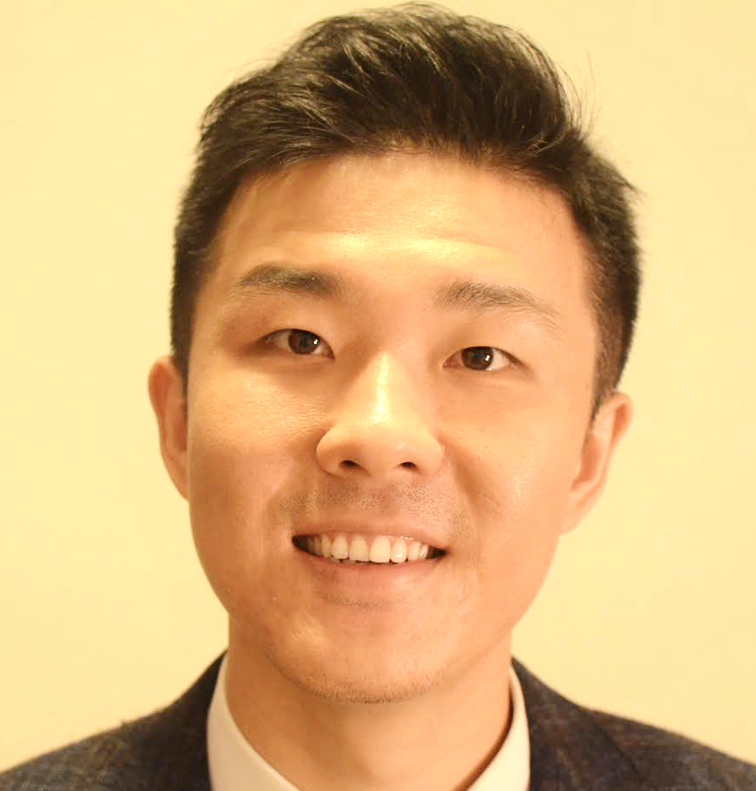
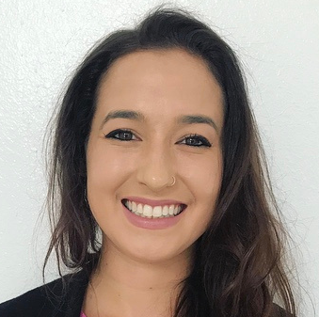
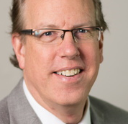
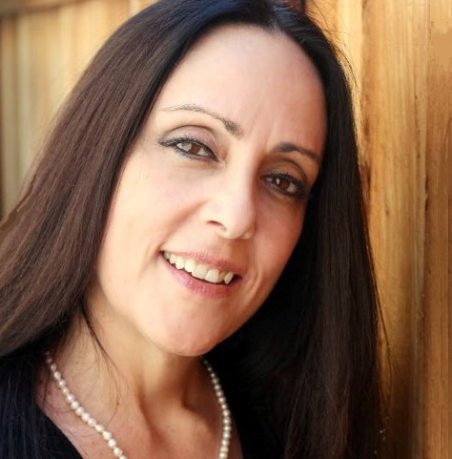

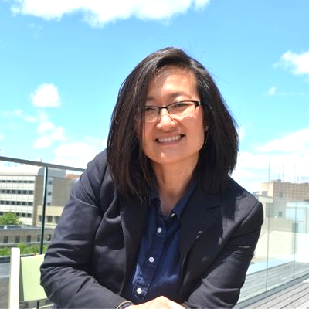
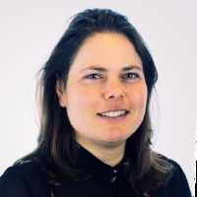
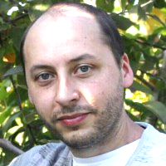
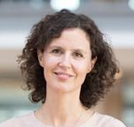
Diabetes & Obesity Domain Team
UNC
PREMISE:
Novel antihyperglycemic medications have associated cardiorenal benefits and reduced mortality in diabetes.
QUESTION:
How are anti-hyperglycemic medications with established cardiorenal and mortality benefits associated with mortality among patients with type 2 diabetes and COVID-19, compared to commonly used diabetes medications?
John Buse
Richard Moffitt
Carolyn Bramante
Anna Kakhoska
Tanner Zhang
Steve Johnson
Davera Gabriel
Harold Lehmann
Trine Abrahamsen
Stephanie Hong
Janos
Hajagos
Kajsa Kvist
Notes:
Team (Academia & Industry Collaborators): Clinician, biostatistics, pharmacoepidemiology, programmer, clinical informatician, trainee(s)
Approach: Active comparator design, total maximum likelihood estimators and propensity score matching

Slide 35
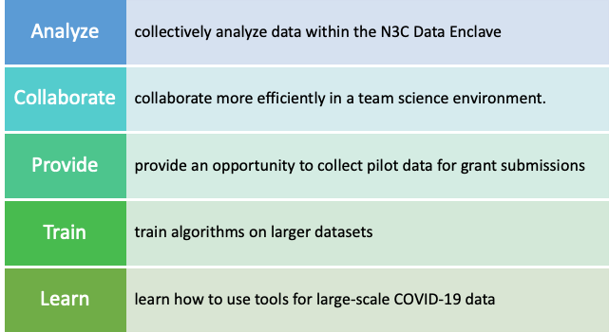
N3C Collaborative Analytics Domain Teams
Each Domain Team enables researchers with shared clinical questions surrounding COVID-19 to:
Notes:
Charisse Madlock-Brown

Slide 36
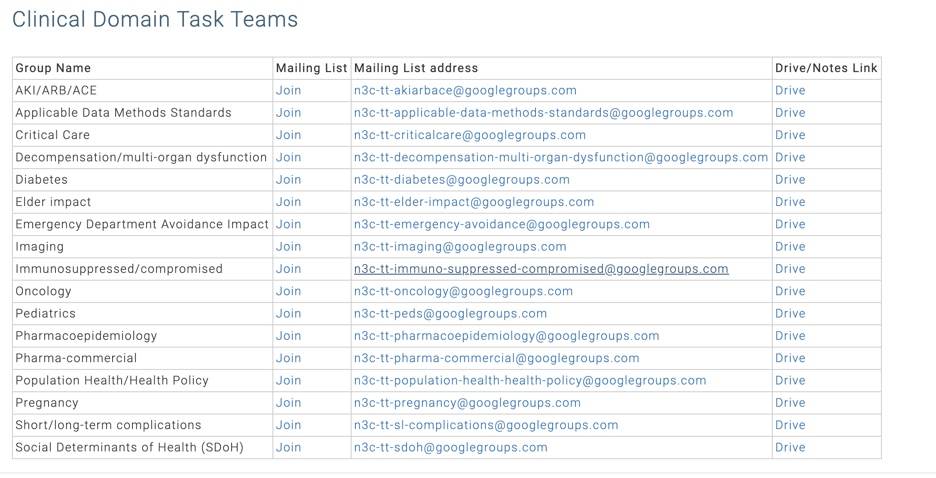
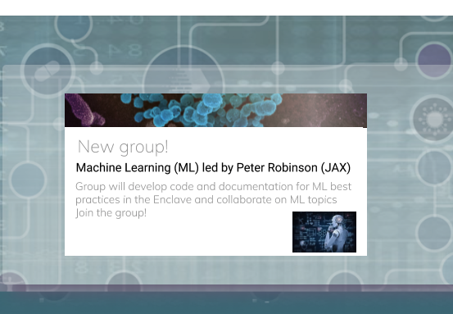
Some of the Clinical Domain Teams
covid.cd2h.org/teams

Slide 37
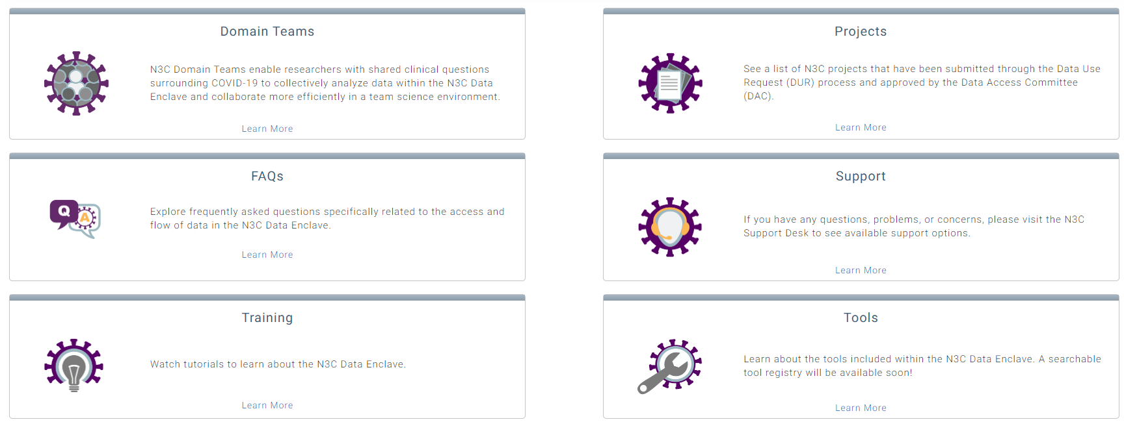
Domain Teams- Common Resources
To Join Domain Teams: Access the N3C Data Enclave/Enclave Essentials

Slide 38
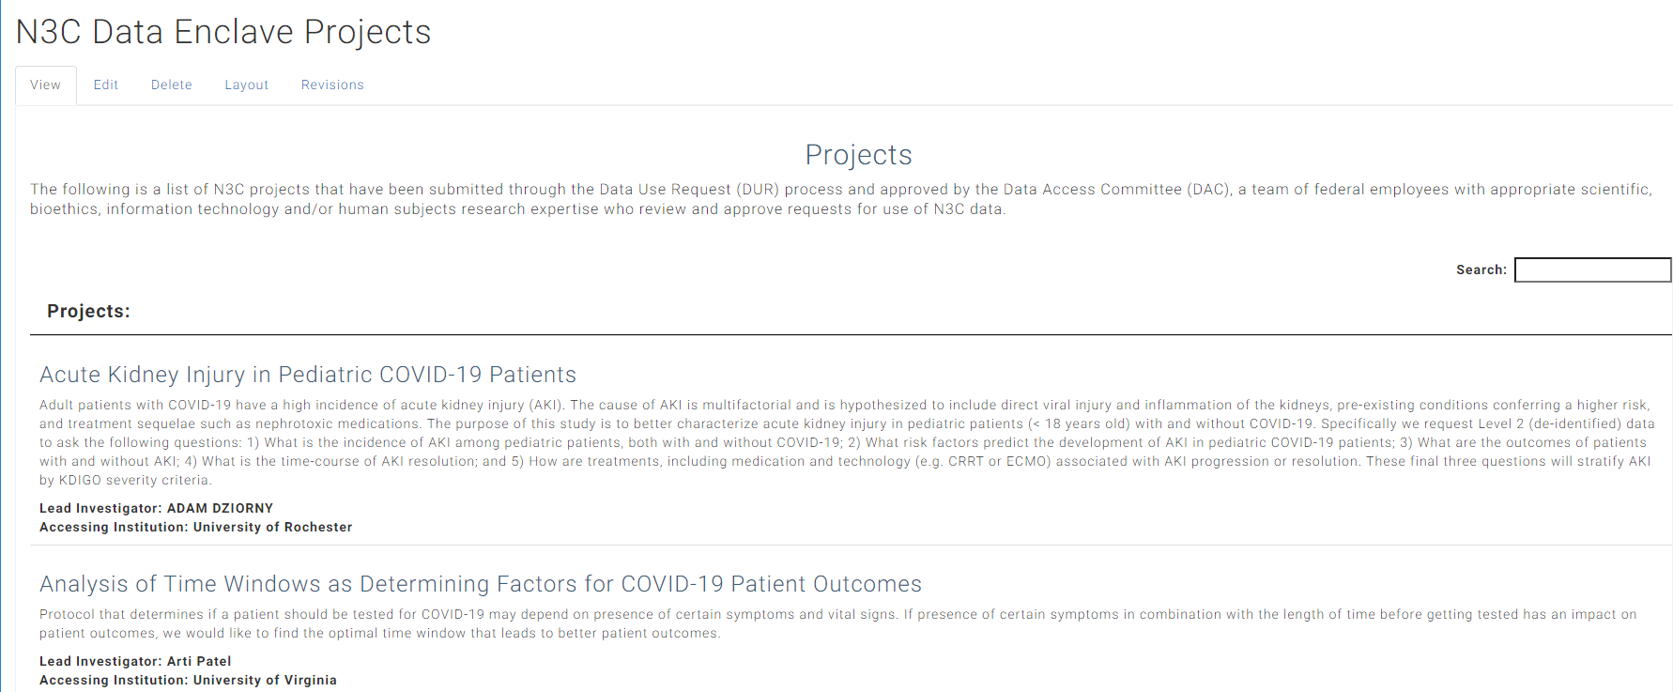
Approved Enclave Projects
https://covid.cd2h.org/enclave_projects
View the list of N3C Data Enclave Projects that have been approved by the Data Access Committee (DAC).

Slide 39



N3C Data Access: Process
Data Use Agreement
Data Use Request
HSP / Security Training
https://ncats.nih.gov/n3c/about/applying-for-access

Slide 40
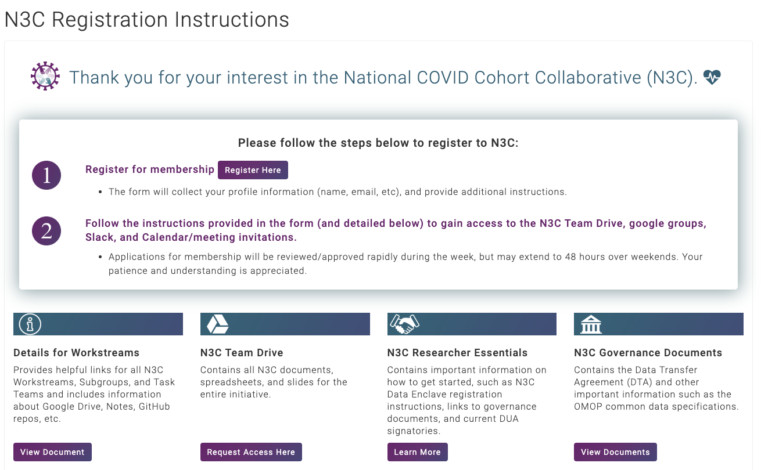
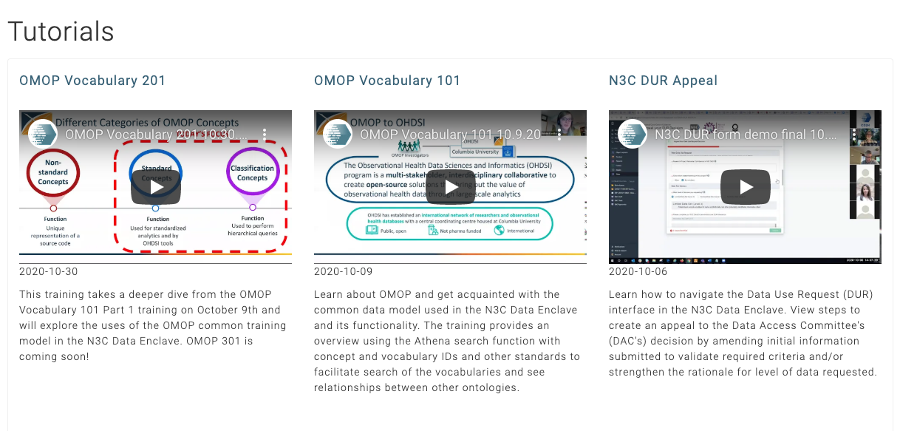
N3C Registration/Training
https://covid.cd2h.org/Tutorials
Registration for Documents, Meetings & the N3C Data Enclave
Requires Authentication
Enclave Checklist
Training Office Hours:
Tuesdays & Thursdays at 10-11 am PT/1-2 pm ET Registration Required at this link
Orientation Video Coming Soon
Additional Training Tutorials available in the Enclave

Slide 41



How to Get Involved with N3C
Register with N3C: https://labs.cd2h.org/registration/
Joining Workstreams:
N3C Data Ingestion & Harmonization Workstream
Slack Channel Harmonization
Google Group Harmonization
N3C Phenotype & Data Acquisition Workstream
Slack Channel Phenotype
Google Group Phenotype
N3C Collaborative Analytics Workstream
Slack Channel Analytics
Google Group Analytics
N3C Data Partnership & Governance Workstream
Slack Channel Governance
Google Group Governance
N3C Synthetic Clinical Data Workstream
Slack Channel Synthetic
Google Group Synthetic
N3C Implementation Workstream- Coming soon
NCATS N3C Webpage
N3C Website
Additional Information:
Onboarding N3C, Slack, Google | Finding and Joining a Google Group

Slide 42

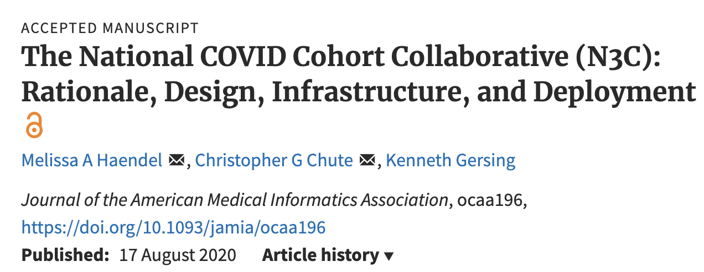


bit.ly/n3c-methods-jamia
Melissa A. Haendel,^{1,4,7,8,10,13,14,52,78,101} Christopher G. Chute,^{1,4,8,10,13,14,52,78,100,101} Tellen D. Bennett,^{9,10,13,14,52,100,101} David A. Eichmann,^{4,9,10,13,78,101} Justin Guinney,^{4,9,10,14,78,101} Warren A. Kibbe,^{9,10,52,78,101} Philip R.O. Payne,^{4,9,10,78,101} Emily R. Pfaff,^{9,10,13,15,52,78} Peter N. Robinson,^{4,9,10,15,52,78,100} Joel H. Saltz,^{10,13,14,15,52,78,101} Heidi Spratt,^{9,10,100} Christine Suver,^{10,78,101} John Wilbanks,^{10,78,101} Adam B. Wilcox,^{10,101} Andrew E. Williams,^{10,13,78} Chunlei Wu,^{9,13,14,78} Clair Blacketer,^{15,52} Robert L. Bradford,^{9,52} James J. Cimino,^{10,14,101} Marshall Clark,^{9,15,52} Evan W. Colmenares,^{9,15,52} Patricia A. Francis,⁷⁸ Davera Gabriel,^{9,10,13,14,15,52} Alexis Graves,^{7,9,78} Raju Hemadri,^{9,15,52} Stephanie S. Hong,^{9,15,52} George Hripscak,^{10,52} Dazhi Jiao,^{9,15,52} Jeffrey G. Klann,^{14,52,101} Kristin Kostka,^{9,15,52} Adam M. Lee,^{9,15,52} Harold P. Lehmann,^{9,15,52} Lora Lingrey,^{9,15,52} Robert T. Miller,^{9,15,52} Michele Morris,^{9,15,52} Shawn N. Murphy,^{9,15,52} Karthik Natarajan,^{9,15,52} Matvey B. Palchuk,^{9,15,52} Usman Sheikh,^{9,78} Harold Solbrig,^{9,15,52} Shyam Visweswaran,^{10,15,52,101} Anita Walden,^{7,10,13,14,52,101} Kellie M. Walters,^{10,14,101} Griffin M. Weber,^{10,101} Xiaohan Tanner Zhang,^{9,15,52} Richard L. Zhu,^{9,15,52} Benjamin Amor,⁷⁸ Andrew T. Girvin,^{15,78} Amin Manna,⁷⁸ Nabeel Qureshi,^{15,78} Michael G. Kurilla,^{10,78} Sam G. Michael,^{10,78} Lili M. Portilla,¹⁰¹ Joni L. Rutter,^{1,101} Christopher P. Austin,¹⁰¹ Ken R. Gersing,^{78,101}
Shaymaa Al-Shukri,^{4,15} Adil Alaoui,¹⁰¹ Ahmad Baghal,¹⁵ Pamela D. Banning,^{15,100} Edward M. Barbour,^{8,15} Michael J. Becich,^{15,52,101} Afshin Beheshti,¹⁴ Gordon R. Bernard,^{8,15} Sharmodeep Bhattacharyya,¹⁰⁰ Mark M. Bissell,^{9,15} L. Ebony Boulware,^{14,100} Samuel Bozzette,^{100,101} Donald E. Brown,¹⁰¹ John B. Buse,¹⁴ Brian J. Bush,^{8,101} Tiffany J. Callahan,^{14,52} Thomas R. Campion,^{8,15} Elena Casiraghi,^{9,15} Ammar A. Chaudhry,^{13,14} Guanhua Chen,⁹ Anjun Chen,¹³ Gari D. Clifford,^{8,15} Megan P. Coffee,^{14,100} Tom Conlin,¹⁴ Connor Cook,^{7,78} Keith A. Crandall,^{9,14,101} Mariam Deacy,⁷⁸ Racquel R. Dietz,⁷⁸ Nicholas J. Dobbins,^{8,9} Peter L. Elkin,^{15,52,100} Peter J. Embi,^{52,101} Julio C. Facelli,^{8,15} Karamarie Fecho,¹³ Xue Feng,⁹ Randi E. Foraker,^{8,13,15} Tamas S. Gal,^{8,15} Linqiang Ge,¹⁴ George Golovko,^{15,101} Ramkiran Gouripeddi,^{14,15} Casey S. Greene,^{13,14} Sangeeta Gupta,^{52,101} Ashish Gupta,^{13,101} Janos G. Hajagos,^{9,15} David A. Hanauer,^{15,52} Jeremy Richard Harper,^{9,14,52} Nomi L. Harris,¹⁴ Paul A. Harris,¹⁰¹ Mehadi R. Hassan,⁹ Yongqun He,^{15,52,100} Elaine L. Hill,^{9,14} Maureen E. Hoatlin,¹⁴ Kristi L. Holmes,^{4,101} LaRon Hughes,¹⁴ Randeep S. Jawa,¹⁴ Guoqian Jiang,¹⁴ Xia Jing,^{7,14} Marcin P. Joachimiak,^{8,15} Steven G. Johnson,^{9,14,101} Rishikesan Kamaleswaran,^{9,15,78} Thomas George Kannampallil,^{15,101} Andrew S. Kanter,^{15,52} Ramakanth Kavuluru,^{9,13,14} Kamil Khanipov,^{8,14} Hadi Kharrazi,^{9,14} Dongkyu Kim,^{15,52} Boyd M. Knosp,^{8,15} Arunkumar Krishnan,⁹ Tahsin Kurc,^{9,15} Albert M. Lai,¹⁰¹ Christophe G. Lambert,^{52,101} Michael Larionov,¹⁴ Stephen B. Lee,^{1,14} Michael D. Lesh,⁹ Olivier Lichtarge,¹⁴ John Liu,⁹ Sijia Liu,^{8,9,101} Hongfang Liu,^{9,15} Johanna J. Loomba,^{1,15,78,101} Sandeep K. Mallipattu,^{9,14,15} Chaitanya K. Mamillapalli,¹⁴ Christopher E. Mason,¹⁵ Jomol P. Mathew,^{8,15,52} James C. McClay,¹⁰¹ Julie A. McMurry,^{1,4,7,9,13,14,78} Paras P. Mehta,¹⁴ Ofer Mendelevitch,⁹ Stephane Meystre,^{8,14,15} Richard A. Moffitt,^{9,13,15} Jason H. Moore,^{8,9} Hiroki Morizono,^{13,14,15,52} Christopher J. Mungall,^{15,52} Monica C. Munoz-Torres,^{7,10,78} Andrew J. Neumann,⁷⁸ Xia Ning,¹⁴ Jennifer E. Nyland,^{13,14} Lisa O'Keefe,⁷⁸ Anna O'Malley,⁷⁸ Shawn T. O'Neil,⁷⁸ Jihad S. Obeid,^{10,14,15} Elizabeth L. Ogburn,¹³ Jimmy Phuong,^{9,15,52,100,101} Jose D Posada,^{8,15} Prateek Prasanna,^{14,52} Fred Prior,^{9,14,15} Justin Prosser,^{9,78} Amanda Lienau Purnell,¹⁰¹ Ali Rahnavard,^{9,52} Harish Ramadas,^{9,52,78} Justin T. Reese,^{9,10} Jennifer L. Robinson,^{14,100} Daniel L. Rubin,¹⁰¹ Cody D. Rutherford,^{9,101} Eugene M. Sadhu,^{8,15} Amit Saha,⁹ Mary Morrison Saltz,^{15,52,101} Thomas Schaffter,⁷⁸ Titus KL Schleyer,¹⁴ Soko Setoguchi,^{8,14,15} Nigam H. Shah,^{8,14} Noha Sharafeldin,¹⁴ Evan Sholle,^{15,52} Jonathan C. Silverstein,^{15,52,101} Anthony Solomonides,¹⁰¹ Julian Solway,^{14,101} Jing Su,¹⁰¹ Vignesh Subbian,^{9,52,101} Hyo Jung Tak,¹⁵ Bradley W. Taylor,^{9,14} Anne E. Thessen,^{14,101} Jason A. Thomas,¹⁵ Umit Topaloglu,^{15,52} Deepak R. Unni,^{8,9,15,52} Joshua T. Vogelstein,¹⁴ Andréa M. Volz,⁷ David A. Williams,^{14,15} Kelli M. Wilson,^{9,78} Clark B. Xu,^{8,9,15} Hua Xu,^{9,10,14} Yao Yan,^{9,15,52} Elizabeth Zak,^{8,15} Lanjing Zhang,¹⁰¹ Chengda Zhang,¹⁴ Jingyi Zheng,¹⁴
¹CREDIT_00000001 (Conceptualization) ⁴CREDIT_00000004 (Funding acquisition) ⁷CRO_0000007 (Marketing and Communications) ⁸CREDIT_00000008 (Resources) ⁹CREDIT_00000009 (Software role) ¹⁰CREDIT_00000010 (Supervision role) ¹³CREDIT_00000013 (Original draft) ¹⁴CREDIT_00000014 (Review and editing) ¹⁵CRO_0000015 (Data role) ⁵²CRO_0000052 (Standards role) ⁷⁸CRO_0000078 (Infrastructure role) ¹⁰⁰Clinical Use Cases ¹⁰¹Governance

Slide 43

Questions or Comments?
Notes:
Dr. Ken Gersing - Director of Informatics NCATS DCI
Nabeel Qureshi is the Healthcare Lead for Palantir Technologies

Slide 44
Thank you!
Thank you!

Slide 45

Wrap-Up & Next Steps
Want to get involved?
  Chapters
  Committees
  Communities
  Roundtables
  Learn more at: https://www.himss.org/membership-participation/chapters
Contact:
ihoffberg@himss.org

Slide 46


Earn CAHIMS & CPHIMS credit!
HIMSS is pleased to offer webinar attendees up to one continuing education (CE) hour for use in fulfilling the CE requirements of the Certified Professional in Healthcare Information & Management Systems (CPHIMS) and the Certified Associate in Healthcare Information & Management Systems (CAHIMS) programs.
Visit the HIMSS Professional Development website to learn more.
https://www.himss.org/resources/certification

Slide 47

THANK
YOU!

