Slide 1

PCHAlliance Innovation Exchange:
How Connected Health Tech Addresses
Loneliness Among Seniors
HIMSS and PCHAlliance EVENT

Slide 2
Discussion Points:
The prevalence of loneliness and the severity of its impact on health
Correlations between staying connected and maintaining well-being
What tools are working well, what needs to be improved
How has the pandemic changed the perspective of health systems and individuals

Slide 3
The Impact of Loneliness Among Seniors
Loneliness shaves 8 years off longevity
Loneliness has the largest negative effect on quality of life and is the single largest predictor of dissatisfaction with health care
It’s the “new smoking” considered the equivalent of 15 CIGARETTES per day!
19% of seniors are severely lonely and that has a direct correlation to higher costs of hospitalization
And, has a mortality risk greater than obesity
              [Source: aarp.org/disruptaging]

Slide 4
Technology & Being Connected [Source: aarp.org/disruptaging]
This pandemic has shown light on social isolation and loneliness, but it’s not all bad!
  68% of those 65+ have used technology since the start of the pandemic
  We’ve seen how technology – or rather being able to be connected to people using technology - can change behavior
56% of people 85+ report having NO health limitations and able to live alone
  Being connected not just in the home, but on-the-go (movement)

Slide 5

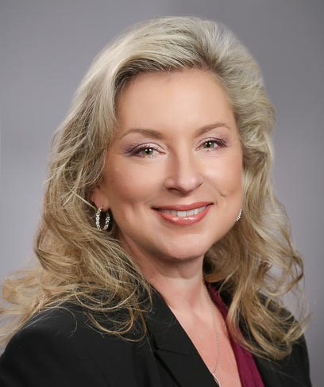
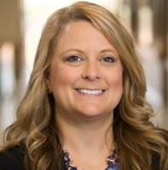
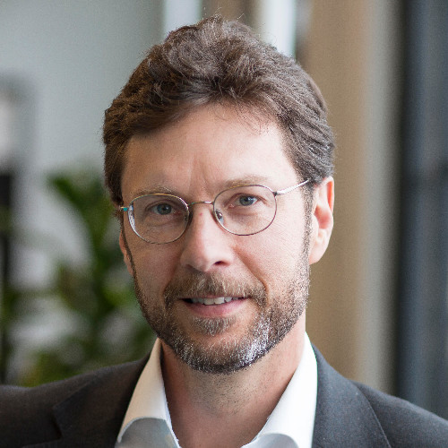
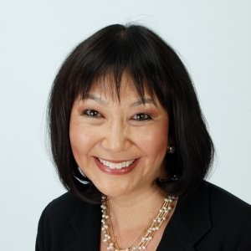

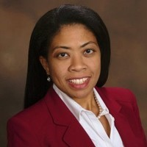
Panelists
Nancy M. Green
Moderator
Co-Chair PCHAlliance Aging & Tech Task Force
Vicki Nolen, LVN MPAD LSSYB
Nathan Treloar
Charlotte Yeh
System Director, Clinical Excellence and Virtual Care
CHRISTUS Health
President and COO
Orbita, Inc.
Chief Medical Officer
AARP Services, Inc.
President
The SAA Group
Fran Ayalasomayajula
Co-Chair PCHAlliance Aging & Tech Task Force
Head of Population Health, Worldwide Healthcare, Strategy and Solutions
HP Inc.

Slide 6
Questions
Please input questions
into Q&A

Slide 7
Speaker Contact Information:
Nancy Green, President, The SAA Group
nancy@thesaagroup.com
https://www.linkedin.com/in/nancymgreen/
Vicki Nolen, System Director, Clinical Excellence and Virtual Care, CHRISTUS Health
vicki.nolen@christushealth.org
https://www.linkedin.com/in/vicki-nolen-lvn-mapd-lssyb-6469611a/
Nathan Treloar, President & COO, Orbita, Inc.
nate@orbita.ai
https://www.linkedin.com/in/ntreloar/
Charlotte Yeh, Chief Medical Officer, AARP Services, Inc.
cyeh@aarp.org
https://www.linkedin.com/in/charlotte-yeh-308415b/

Slide 8
Resources
HIMSS and PCHAlliance COVID-19 initiatives and pages
Industry Call to Action sources, Resources for Individuals, Providers and Vendors – updated continuously
    http://www.pchalliance.org/covid-19-resources
    https://www.himss.org/news/coronavirus
HIMSS20 Digital: Education, innovation and collaboration of the HIMSS Global Health Conference & Exhibition https://www.himss.org/events/himss-digital
HIMSS Analytics Digital Health Indicator https://www.himssanalytics.org/dhi
2. Personal Connected Health Alliance (PCHAlliance), a HIMSS Innovation Company www.pchalliance.or
  Member Engagement and Thought Leadership on Connected Health: Aging & Technology, US Policy including CARES and telehealth, Regulatory including FDA Pre-Cert, European Initiatives like mHealth Hub, Connected Device Interoperability Standards including Continua and IHE
3. HIMSS Learning Center – HIMSS20 and ongoing programming (https://www.himsslearn.org//)

Slide 9
Invitation: Topic Development and Call for Panelists
Upcoming PCHA Innovation Exchange webinars:
In Home Healthcare Delivery Channels and Accessibility for the Aging, Aug. 10, Noon CT
Building Trust in Technology for Adoption of Remote Patient Monitoring to Serve the Elderly, Sept. 14, Noon CT
Submit topic ideas, abstracts and speaking interest for next HIMSS-PCHAlliance Aging & Tech Webinar Series
Submissions and interest in joining PCHA Aging & Tech Task Force:
Jody Toser, PCHAlliance, jtoser@pchalliance.org

Slide 10
PCHAlliance Aging & Technology Task Force participants:
AJ Assaadi, Sr. Director of Development, United Spinal Association
Fran Ayalasomayajula, Head of Population Health, Worldwide Healthcare, Strategy and Solutions, HP Inc.
David Box, Global Managing Director, Star
Nancy Green, President, The SAA Group
Rob Grenfell, Director, Health and Biosecurity, CSIRO
Jennifer Kent, Senior Director, Parks Associates
Mike Mazzola, President, Lamprey Networks
Rob McCray, HIMSS and PCHA Board Member, President, Wireless Life Sciences Alliance
Vicki Nolen, System Director, Clinical Excellence and Virtual Care, CHRISTUS Health
John Sharp, Director, Thought Advisory, HIMSS-PCHAlliance
Alexia Sibony, Vice President Product, Orbita
Jody Toser, Director of Membership, HIMSS-PCHAlliance
Monica Volante, Director, Federal Government Affairs, Philips
Charlotte Yeh, Chief Medical Officer, AARP Services, Inc.

Slide 11
Thank You!
Recording will be sent to all registered participants

